Slide 1
Chile, September 2013
Bill Cotton

Slide 2
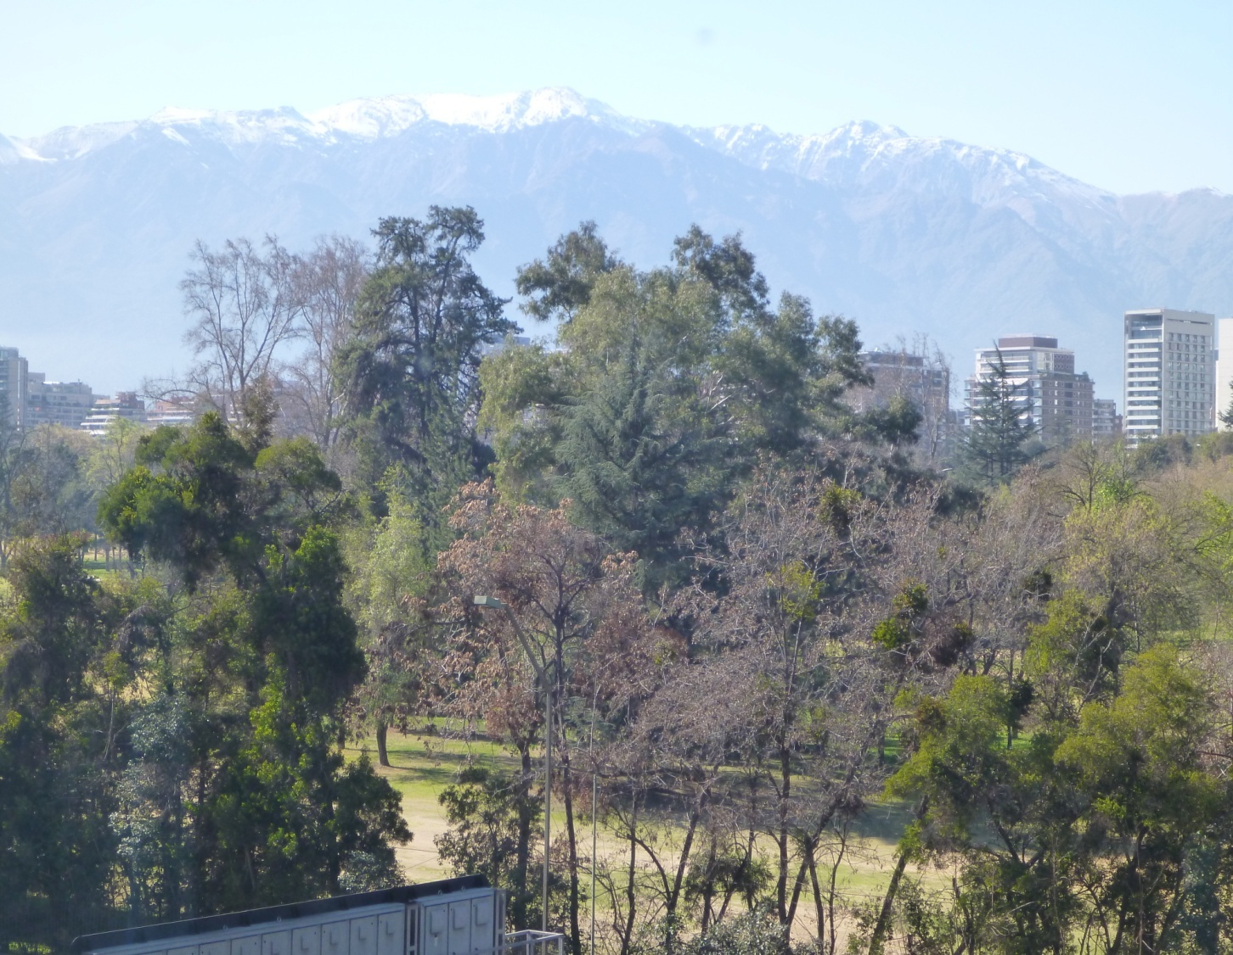
View of Andes from hotel room

Slide 3
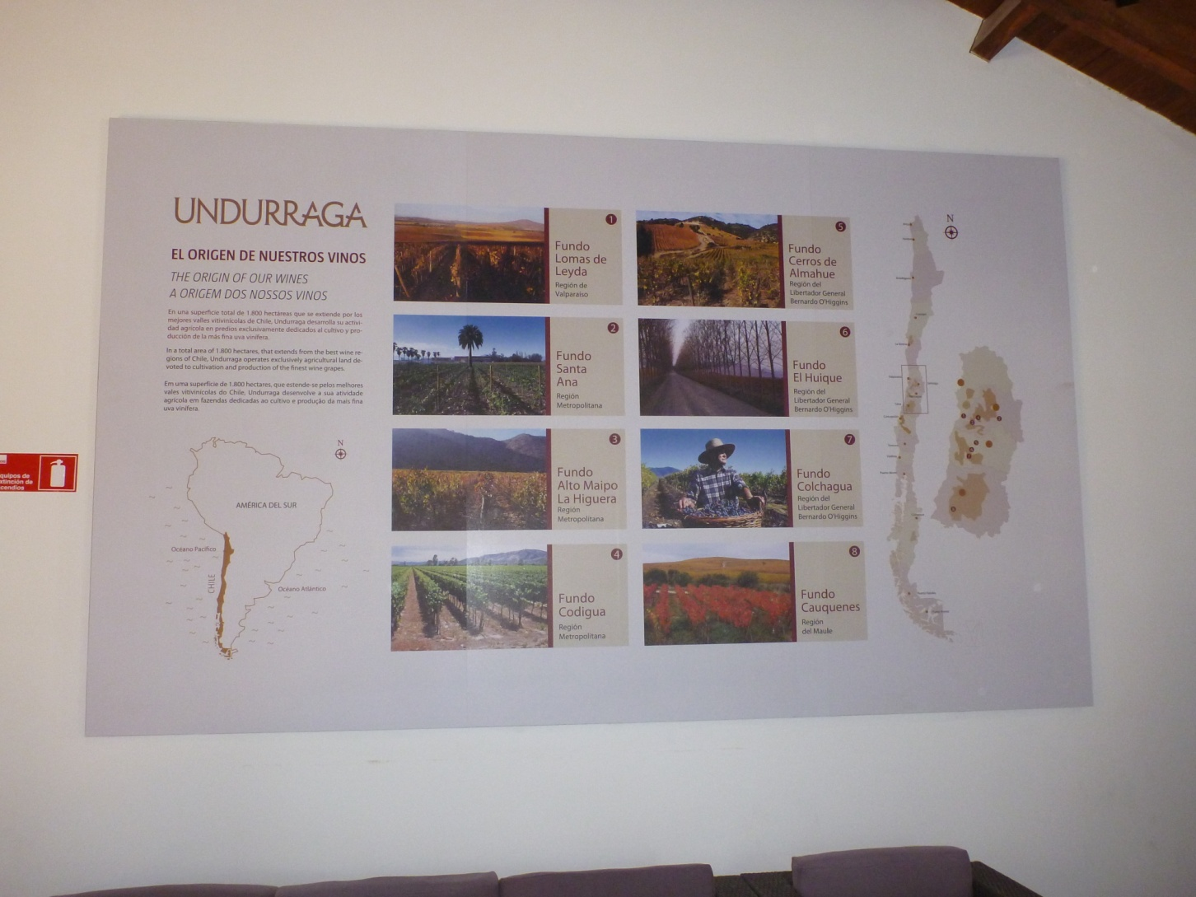
Winery Tour

Slide 4
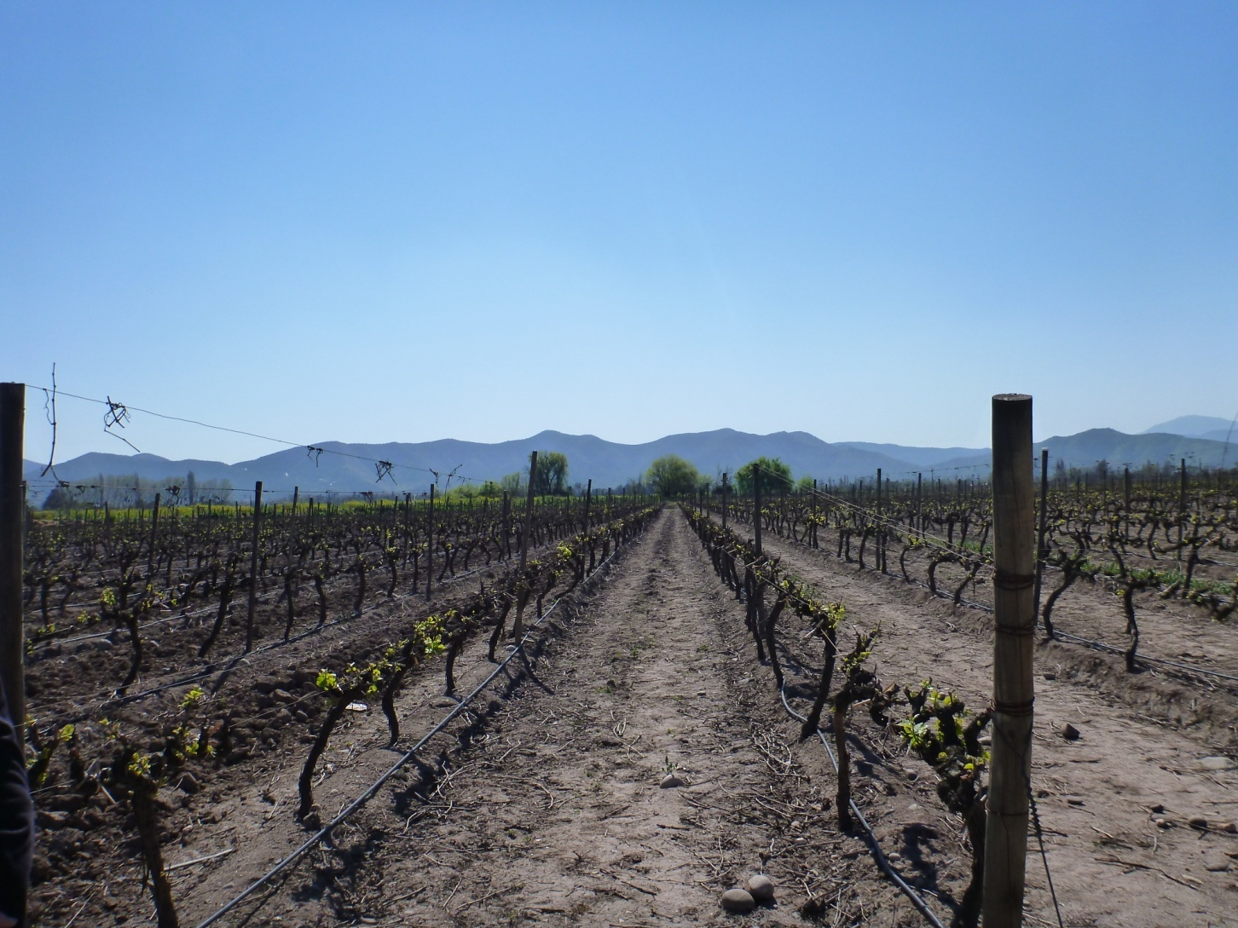

Slide 5
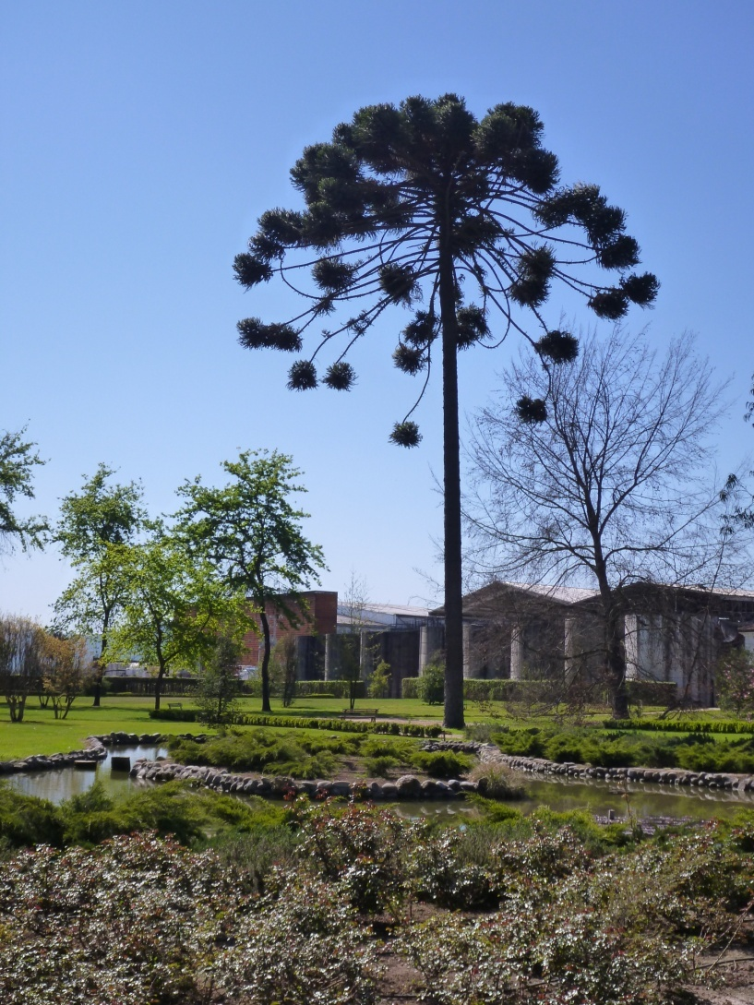
National tree

Slide 6
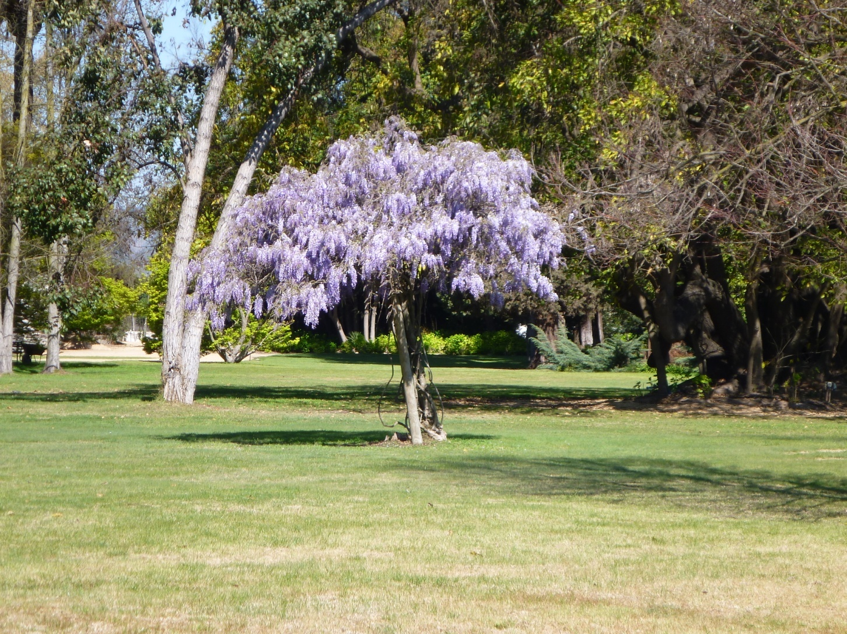
Wisteria in bloom

Slide 7
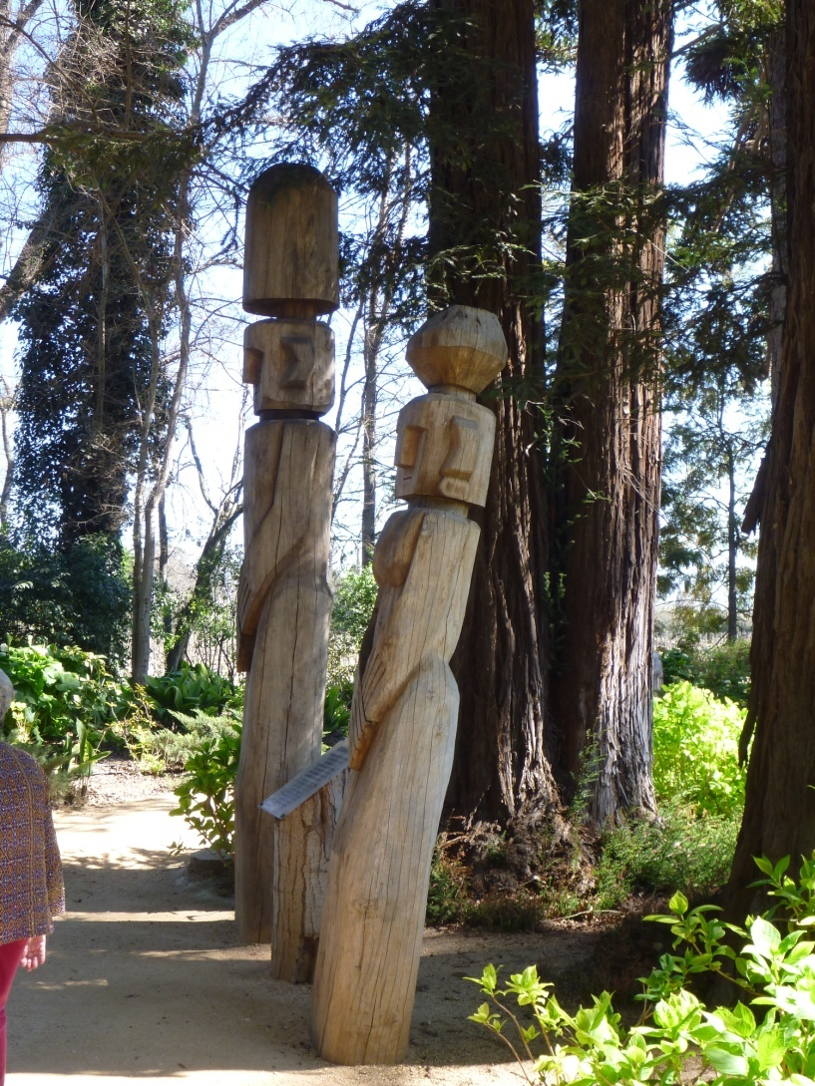
Indigenous totems

Slide 8
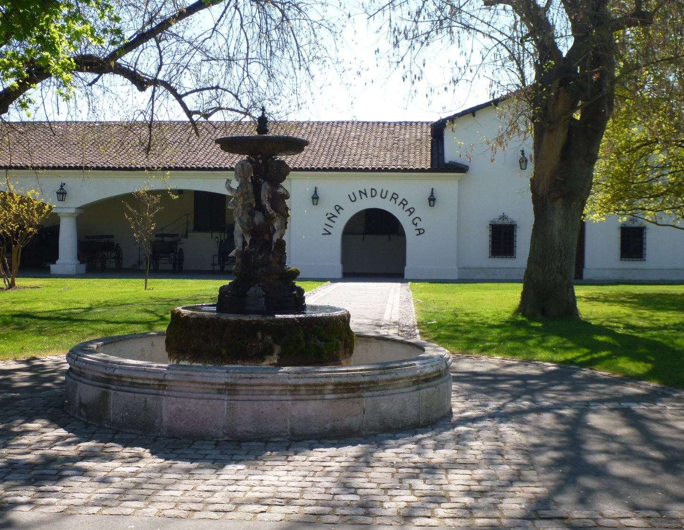

Slide 9
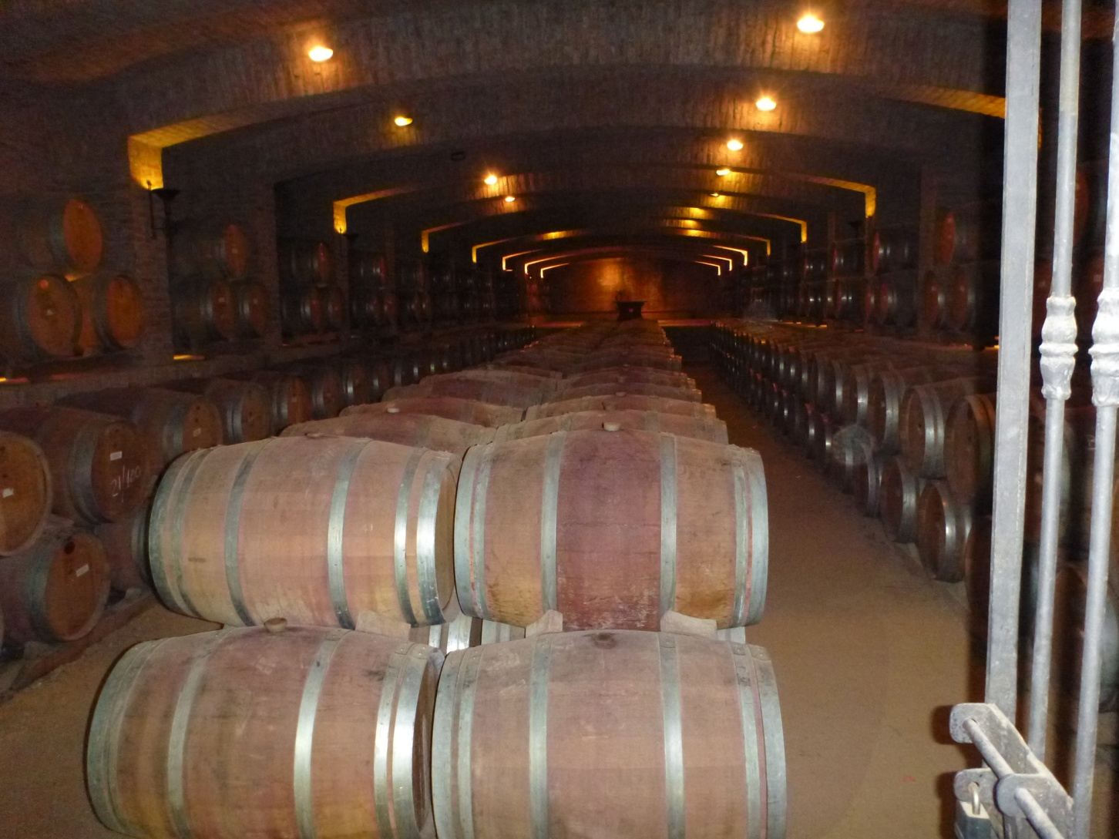

Slide 10
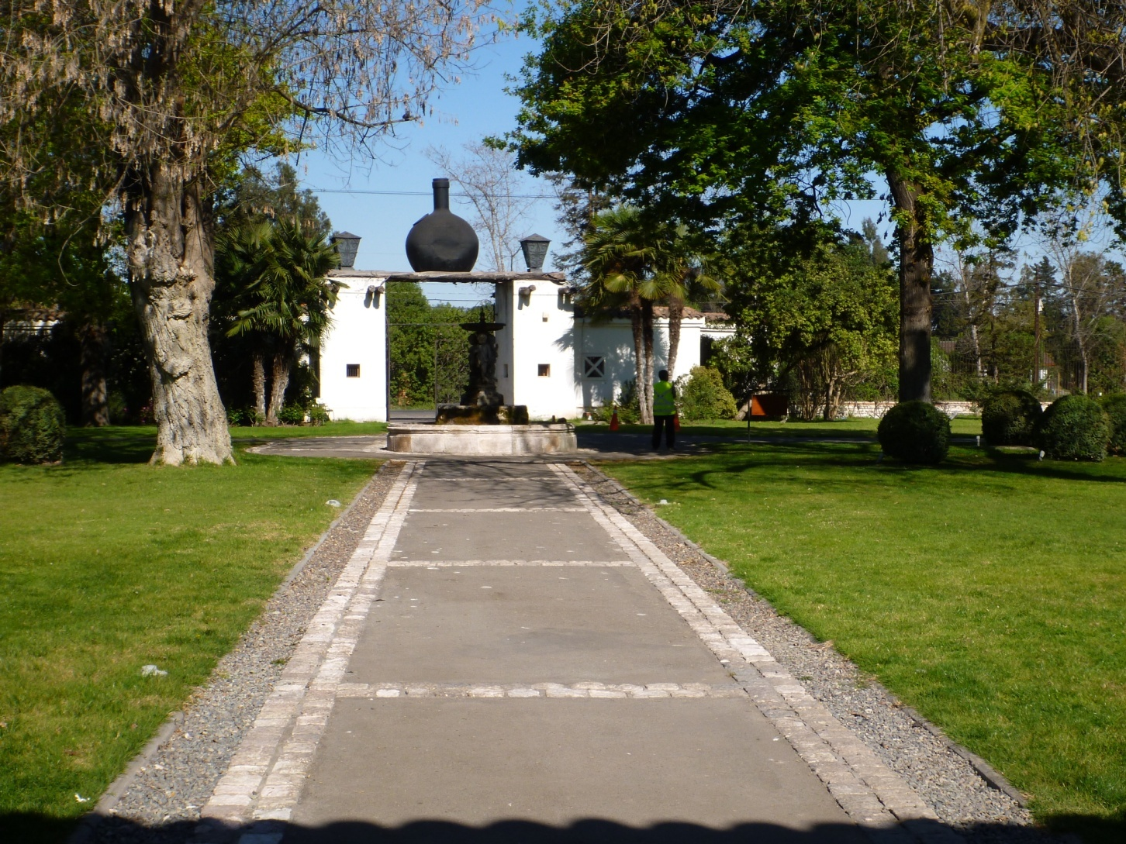
Aft view of entrance

Slide 11
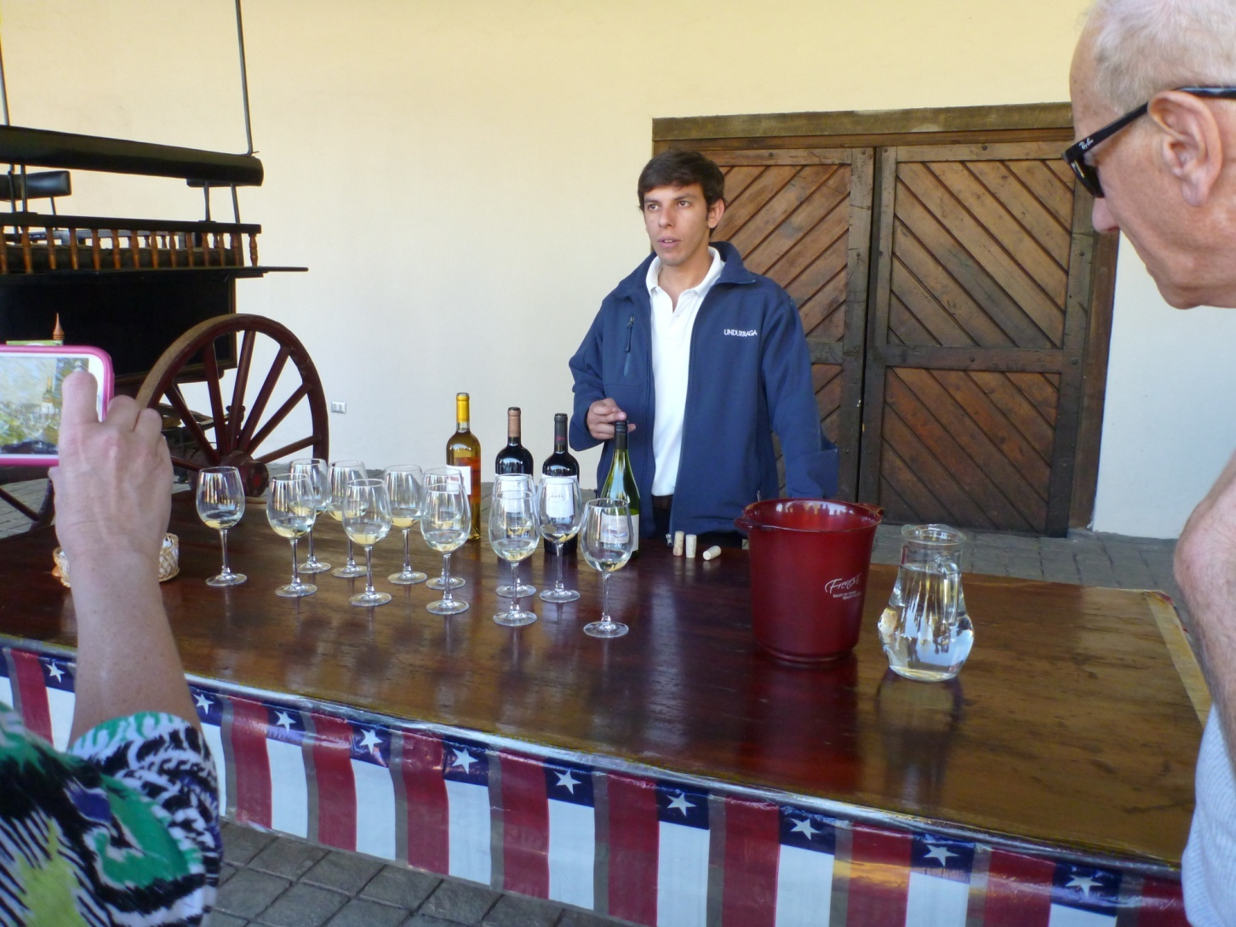
Wine tasting

Slide 12
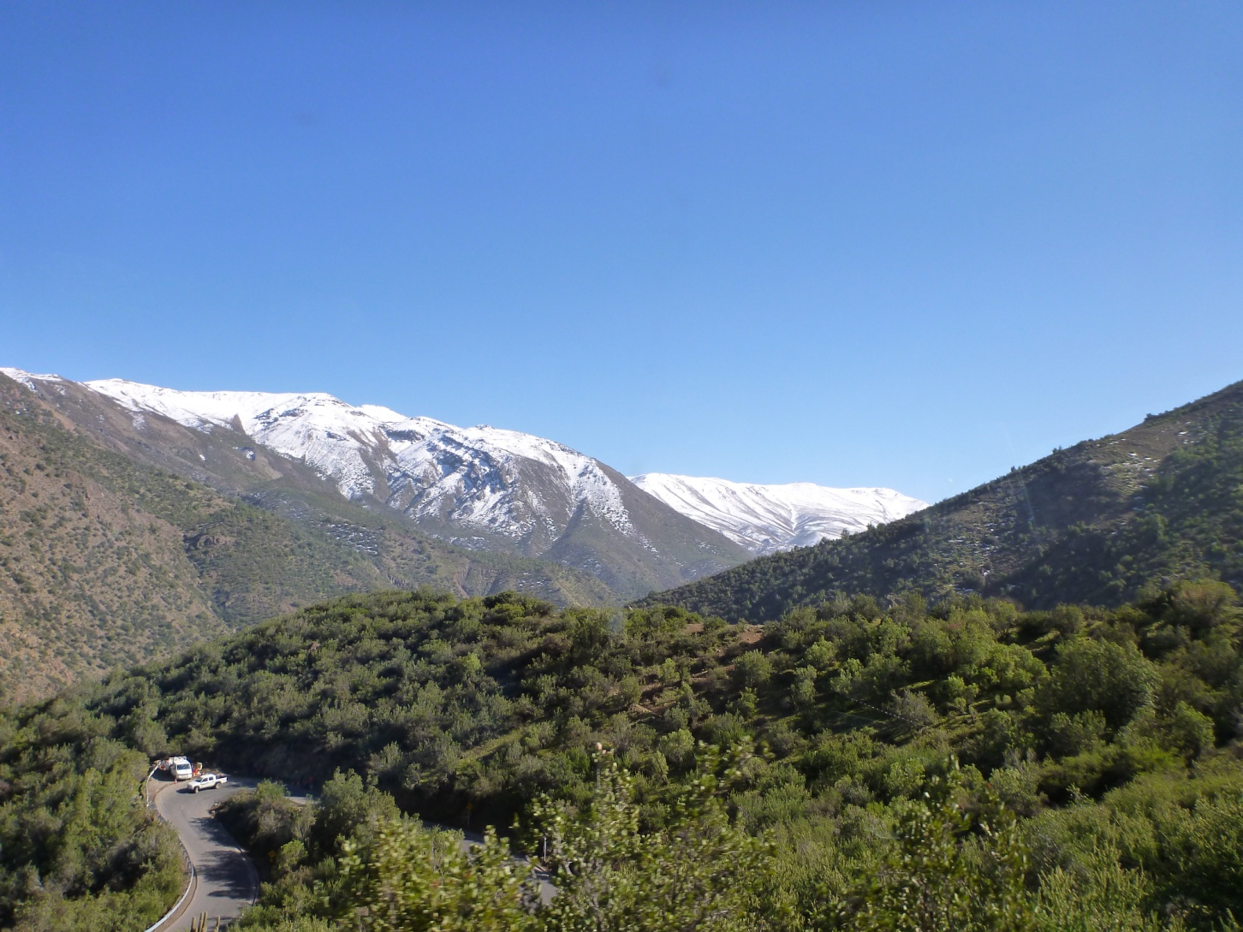
Bus tour to the Andes

Slide 13
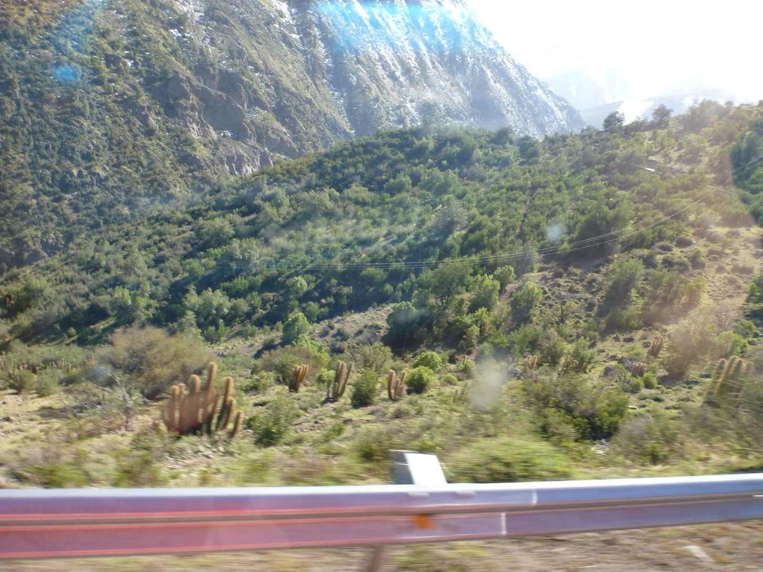
Cacti on north-facing slopes

Slide 14
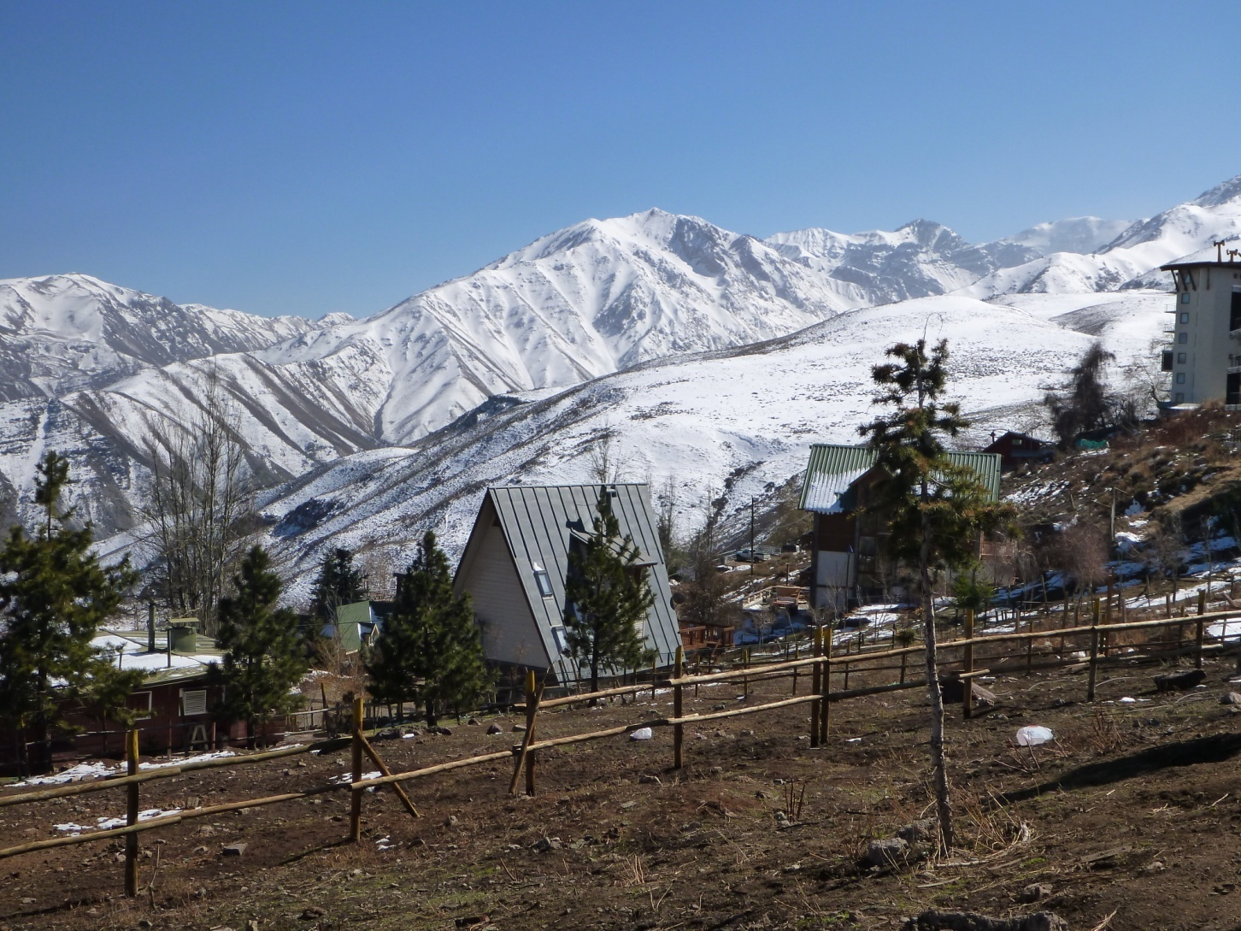
Ski village-mud city 7000’

Slide 15
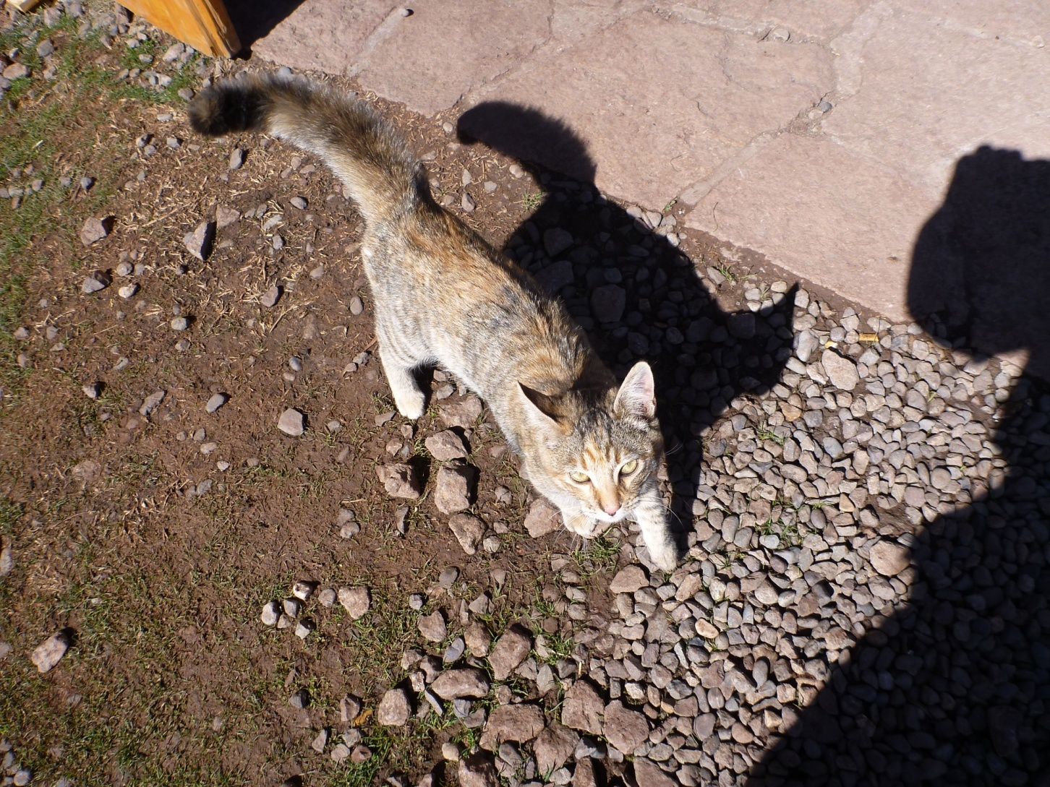
El gato

Slide 16
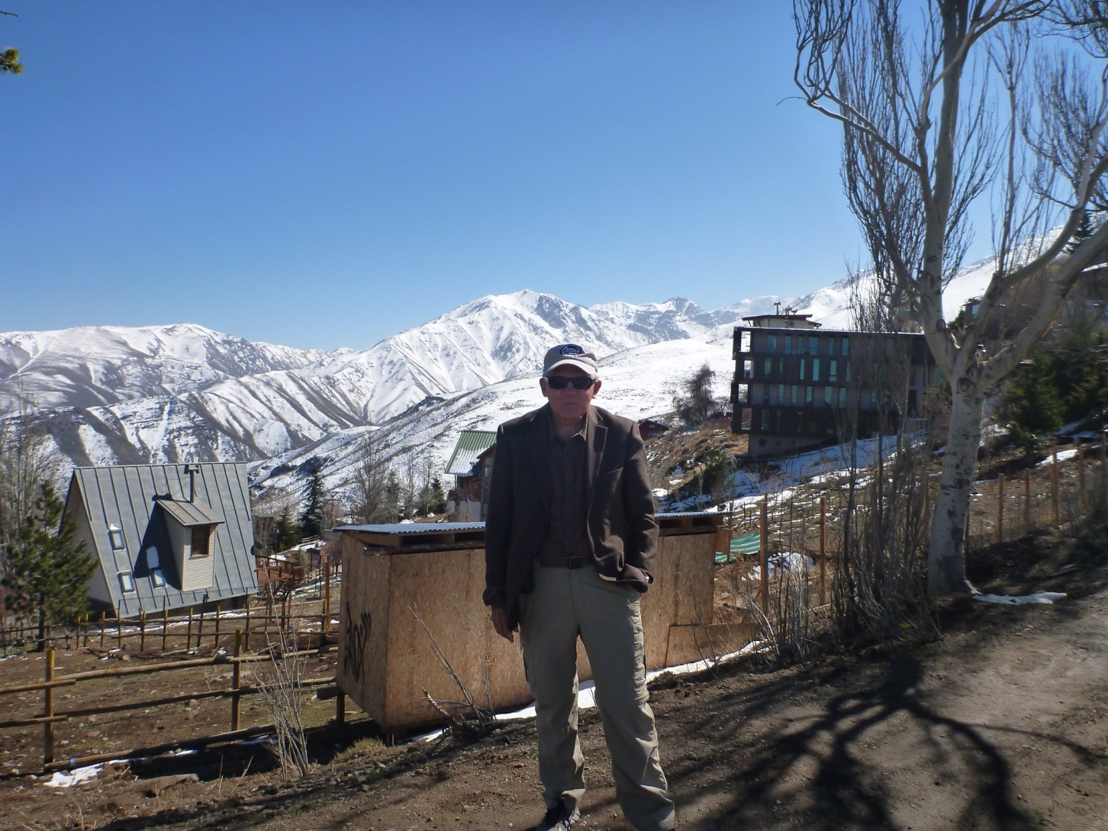
7000’ ski village: mud city

Slide 17
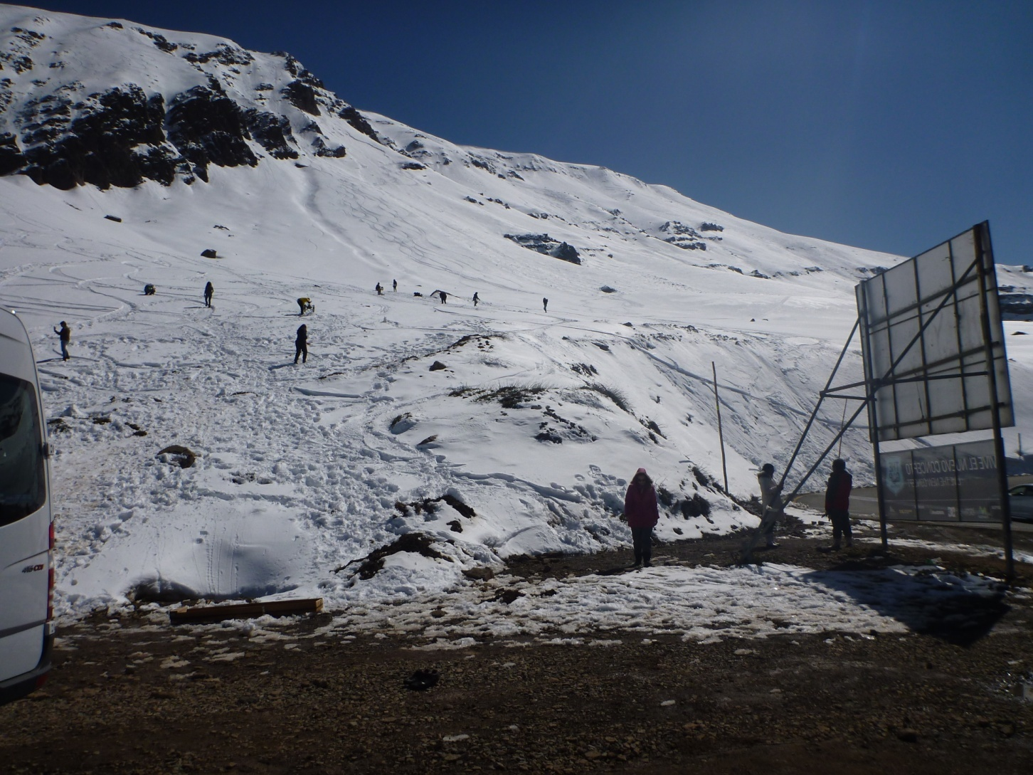
First taste of snow for many

Slide 18
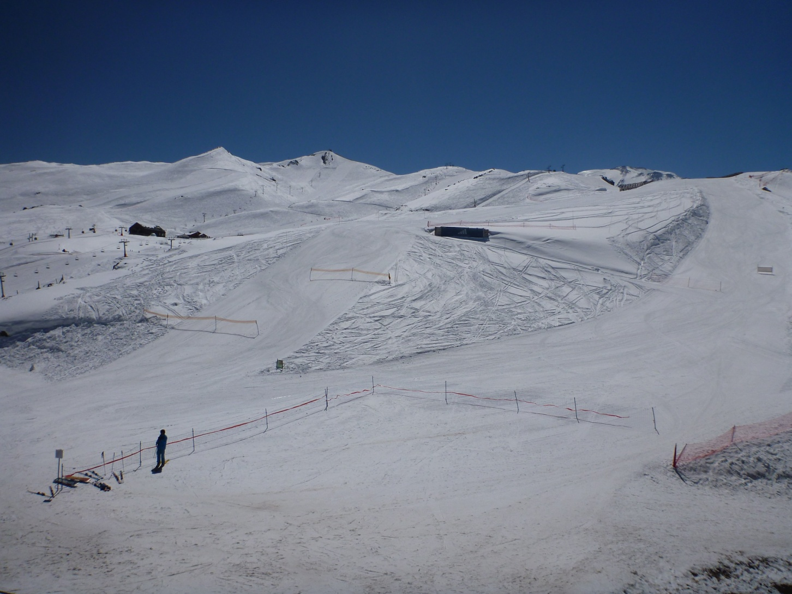
Navado ski resort

Slide 19
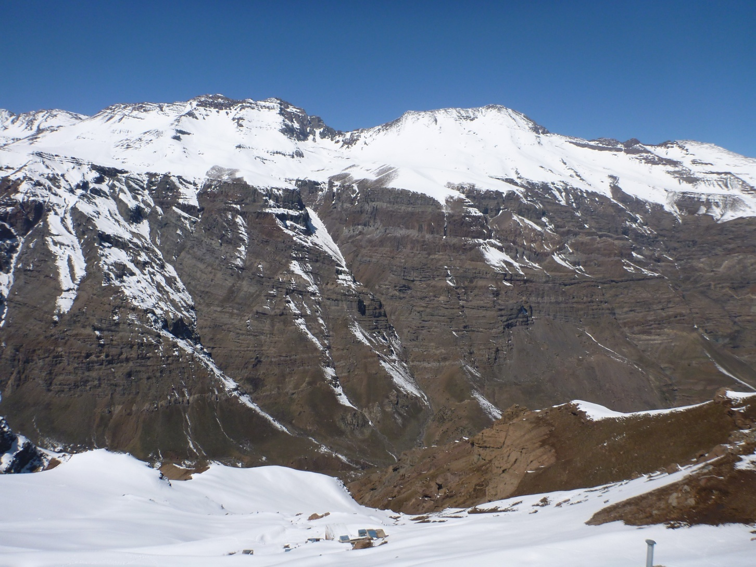

Slide 20
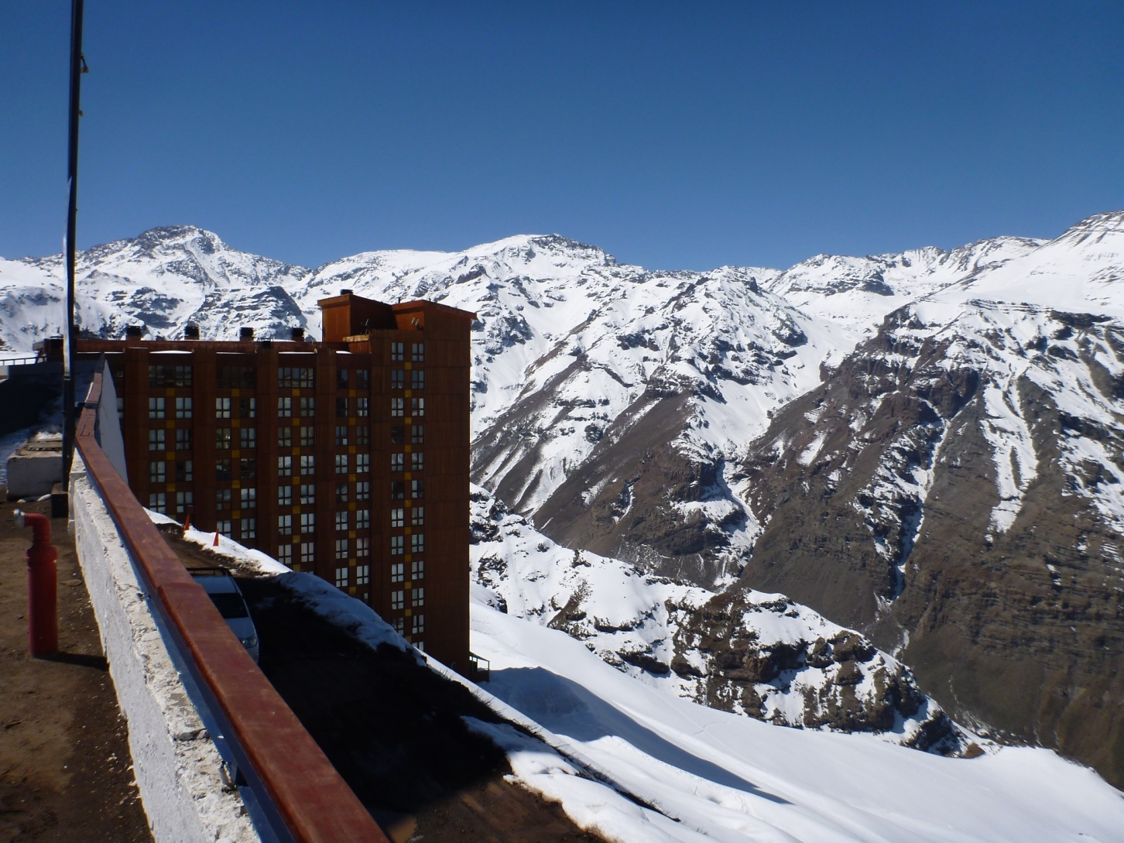

Slide 21
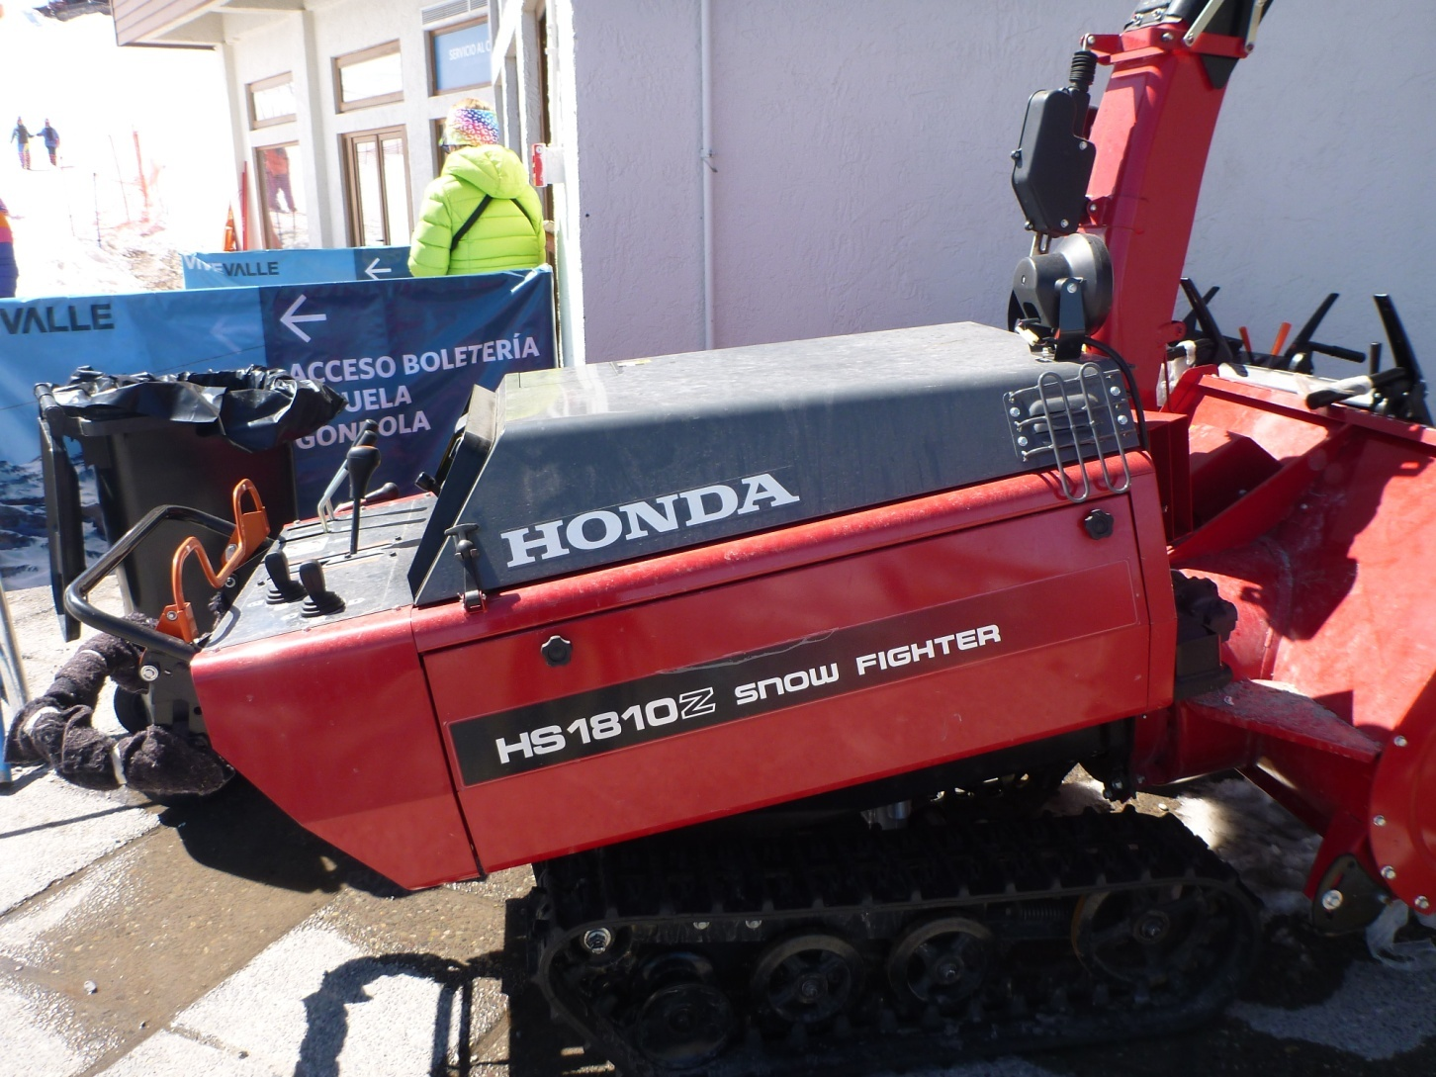
Serious walk-behind snowblower!

Slide 22
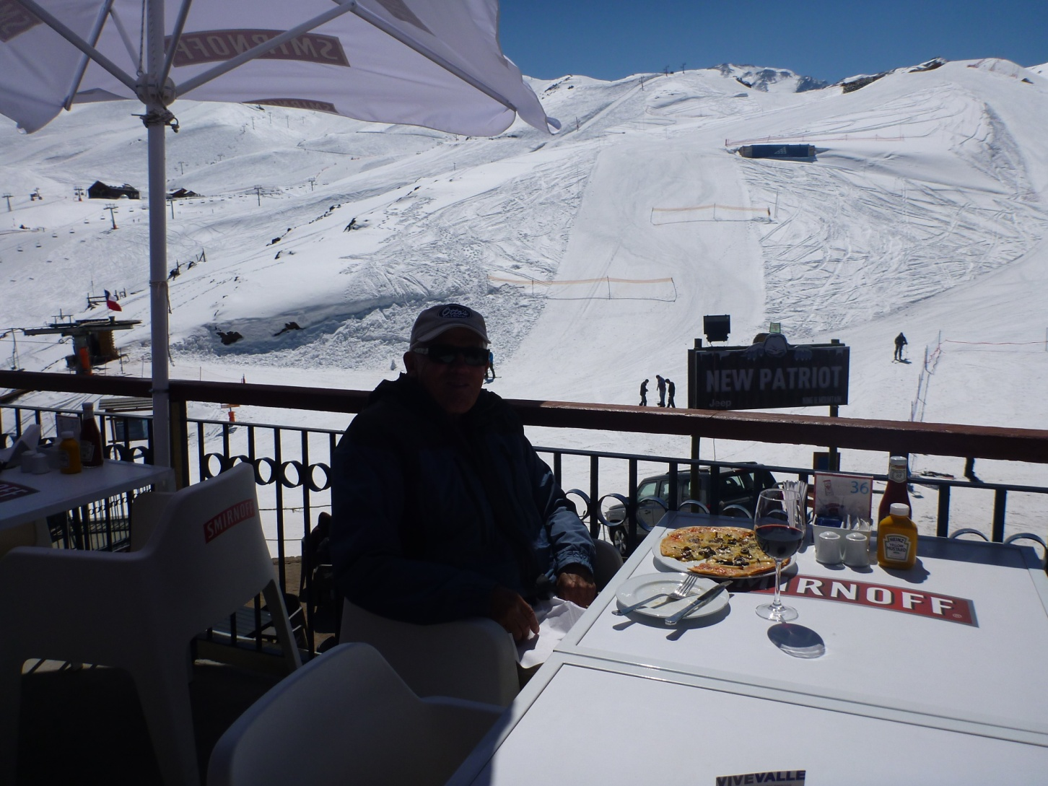
Lunch

Slide 23
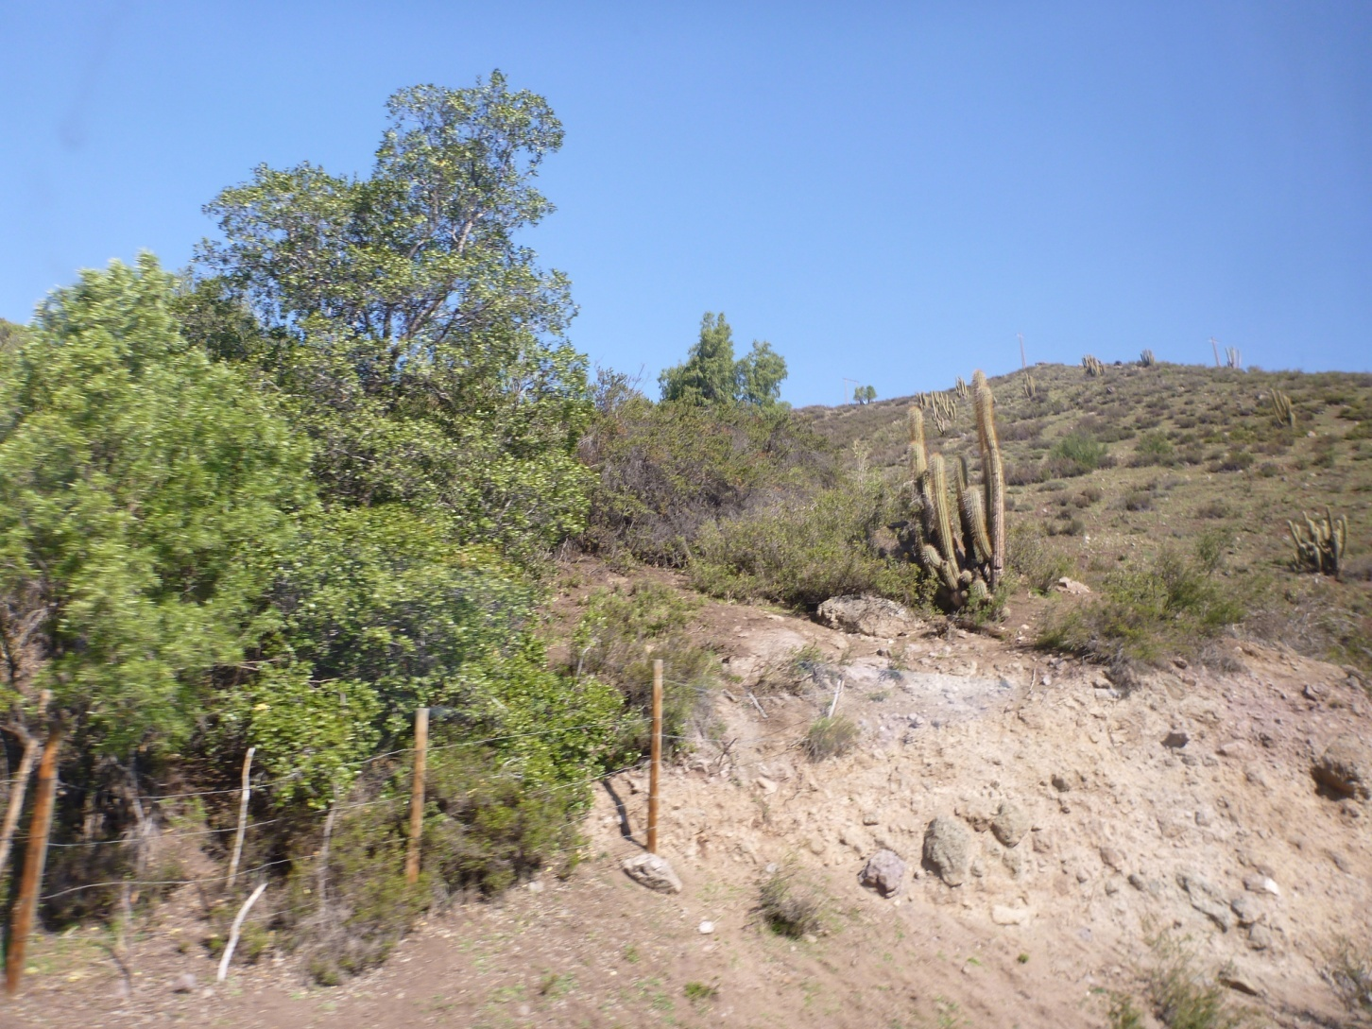
More cacti

Slide 24
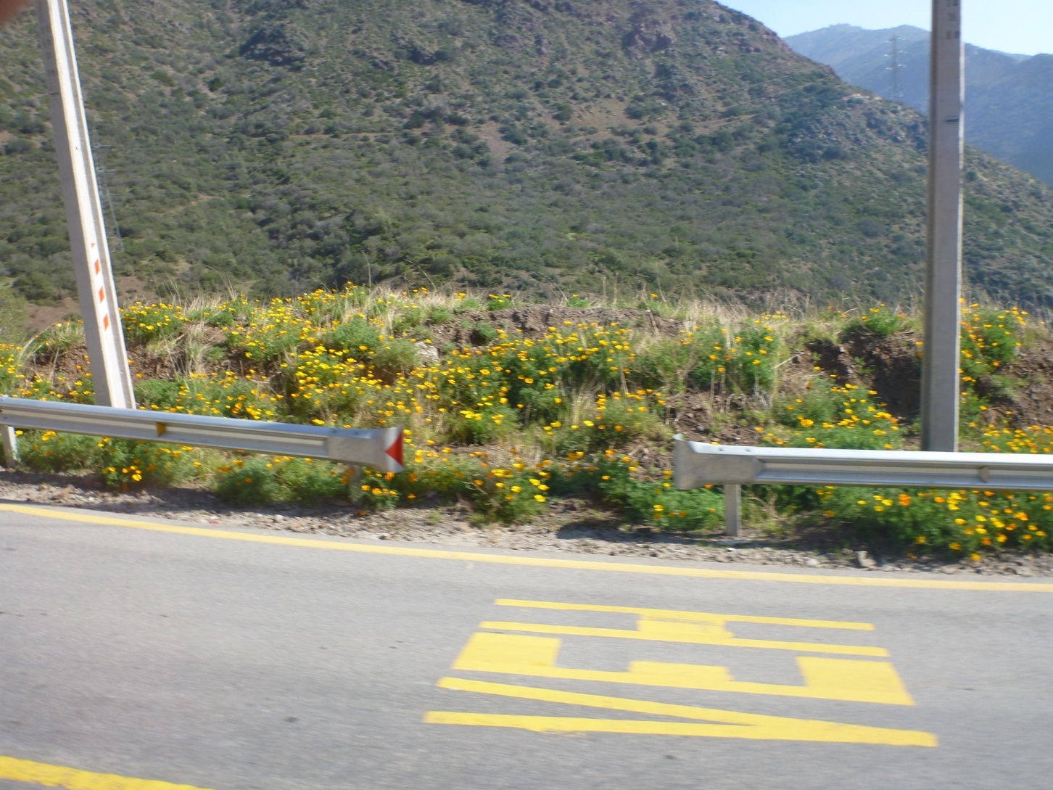
Poppies

Slide 25
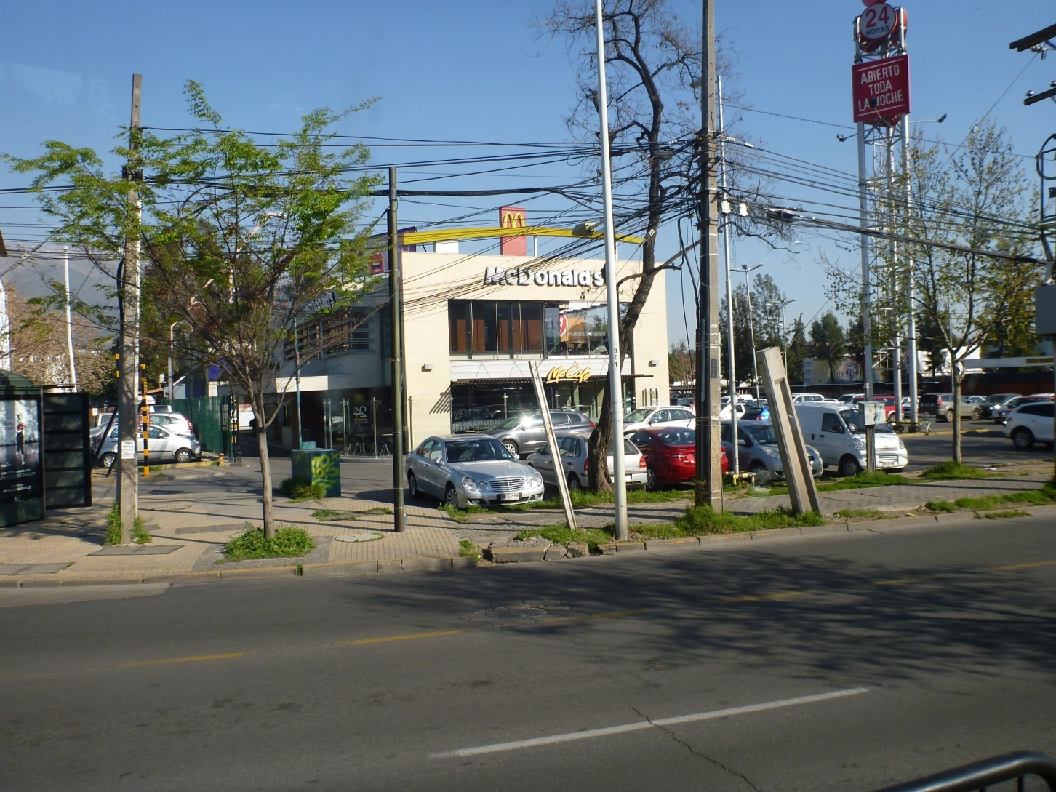
Santiago views

Slide 26
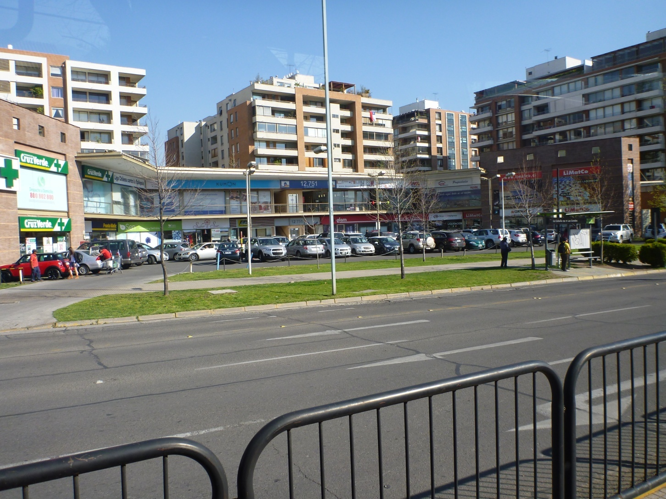

Slide 27
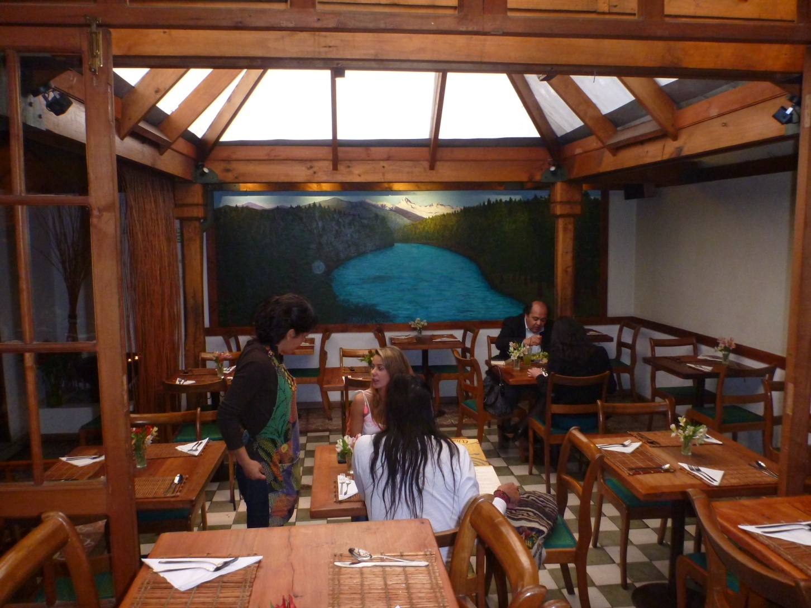
Neat vege restaurant

Slide 28
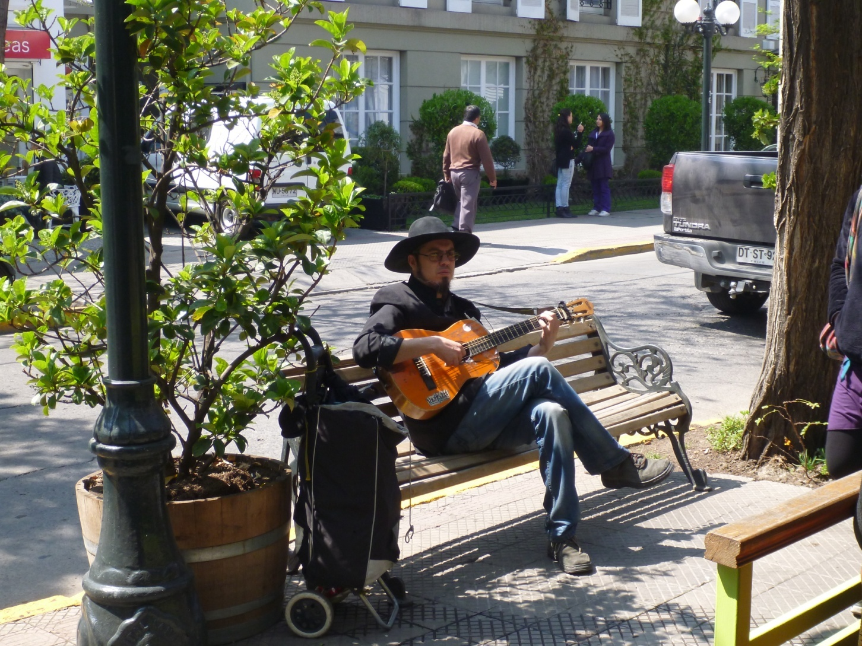
Street musician

Slide 29
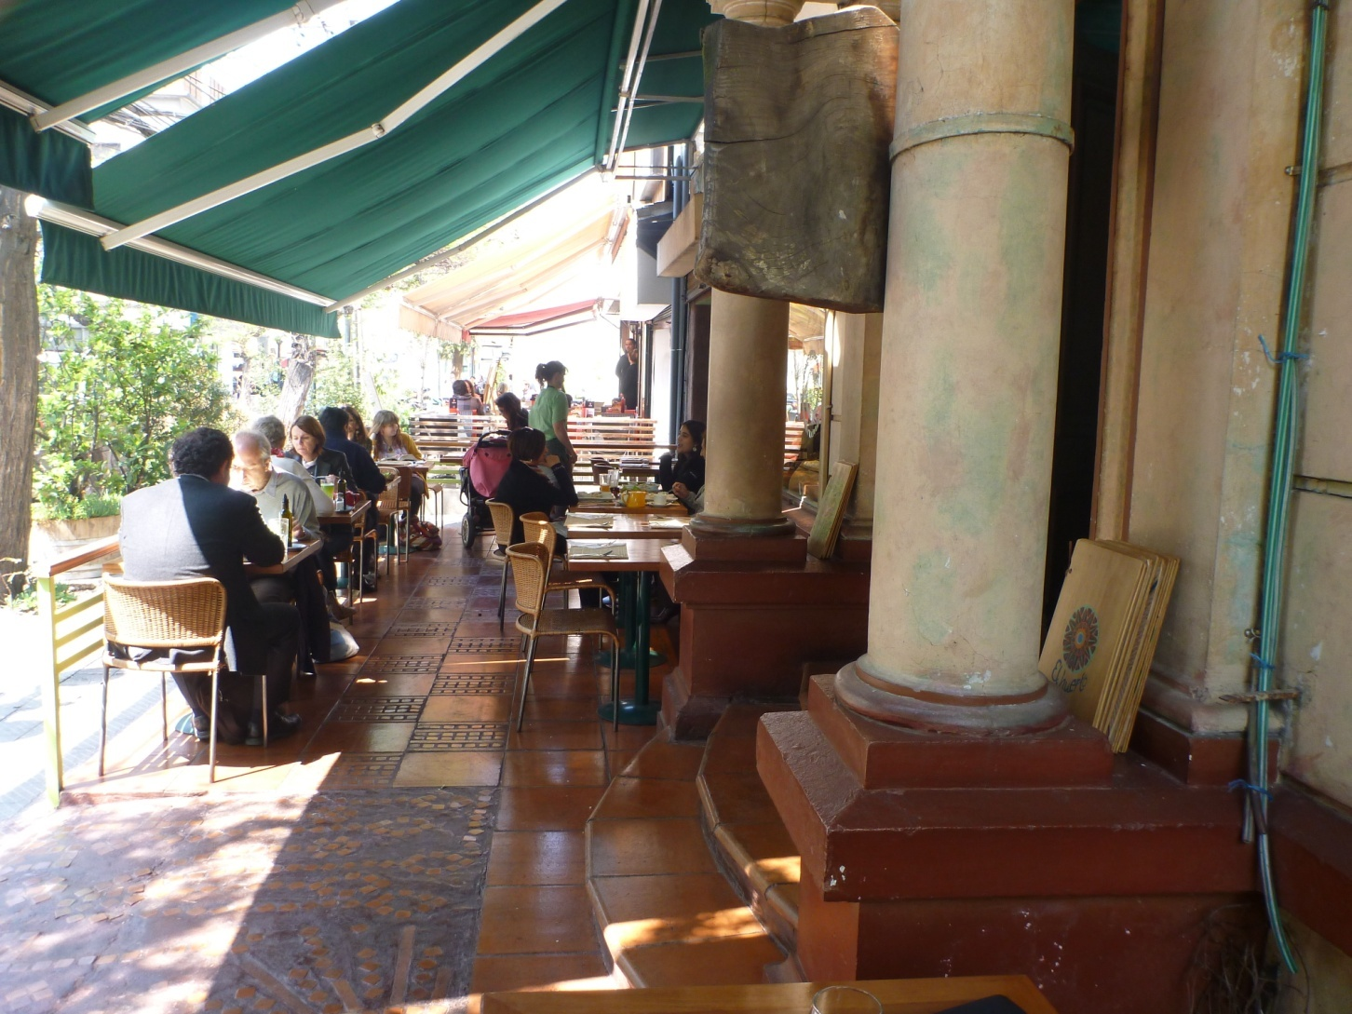

Slide 30
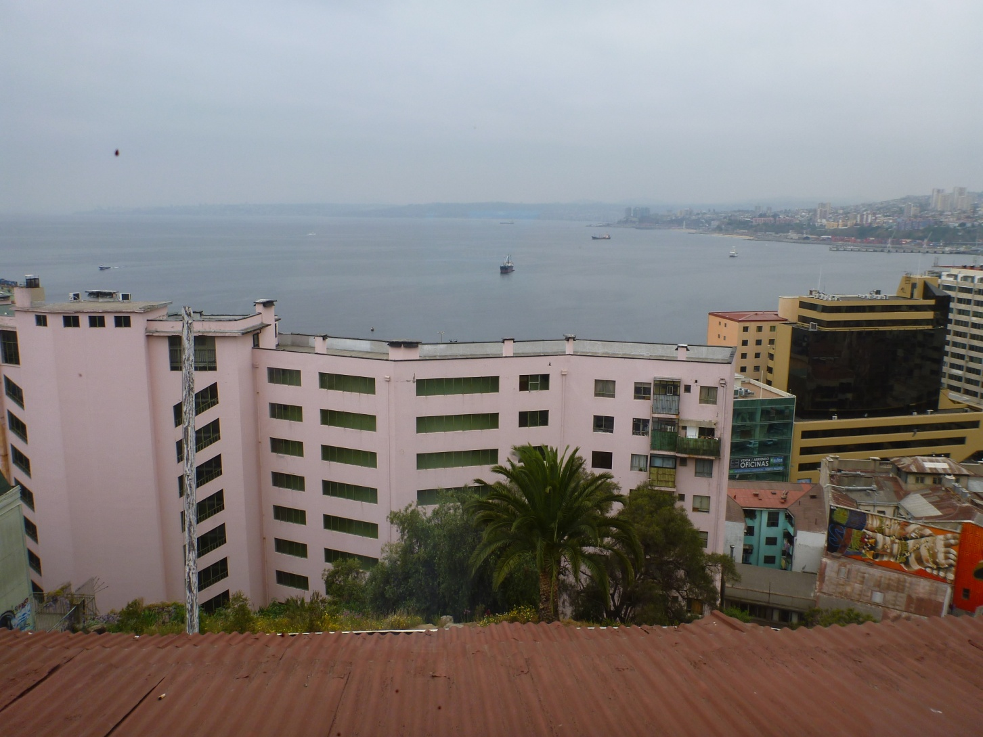
Valpariaso: view from B&B

Slide 31
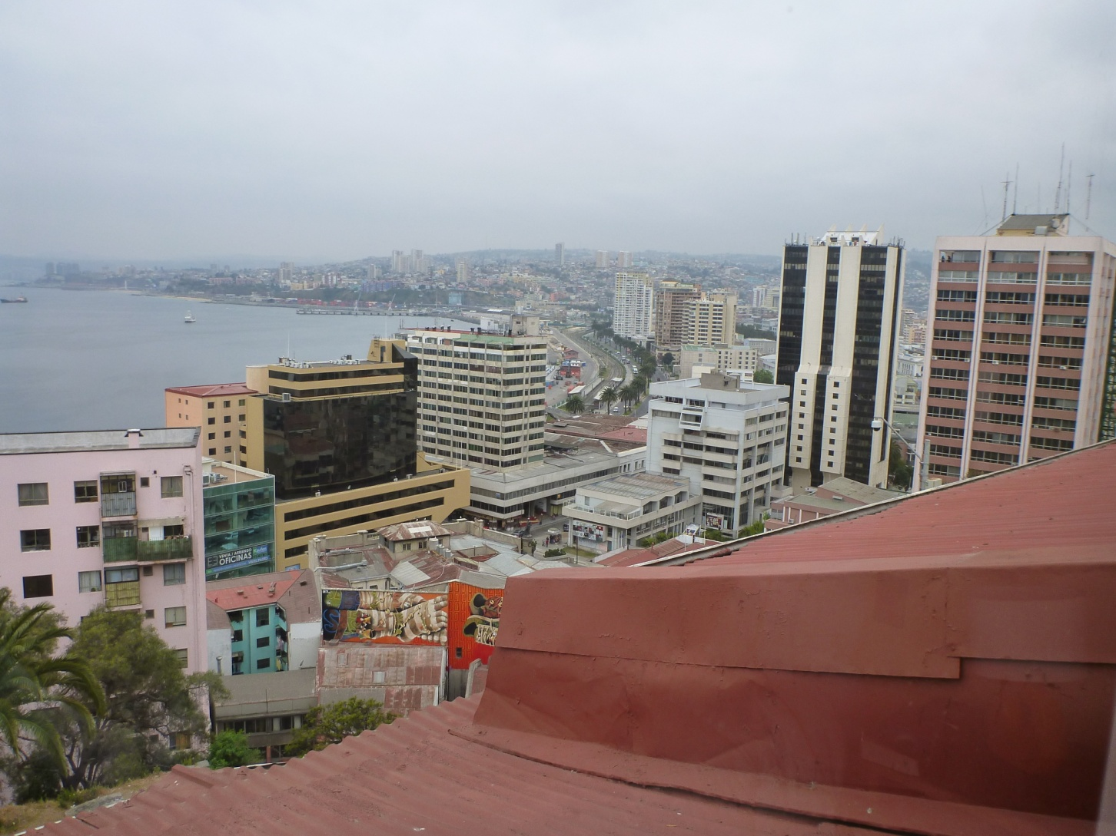

Slide 32
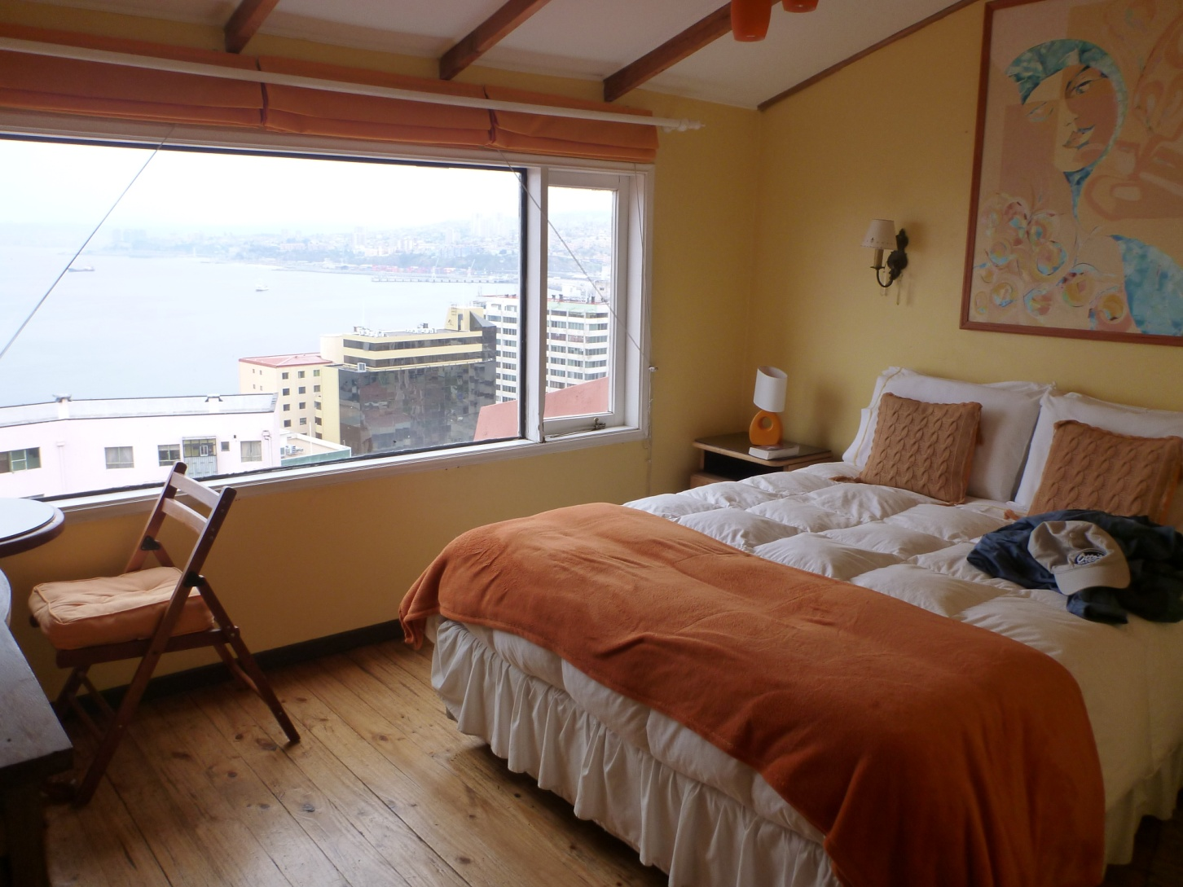

Slide 33
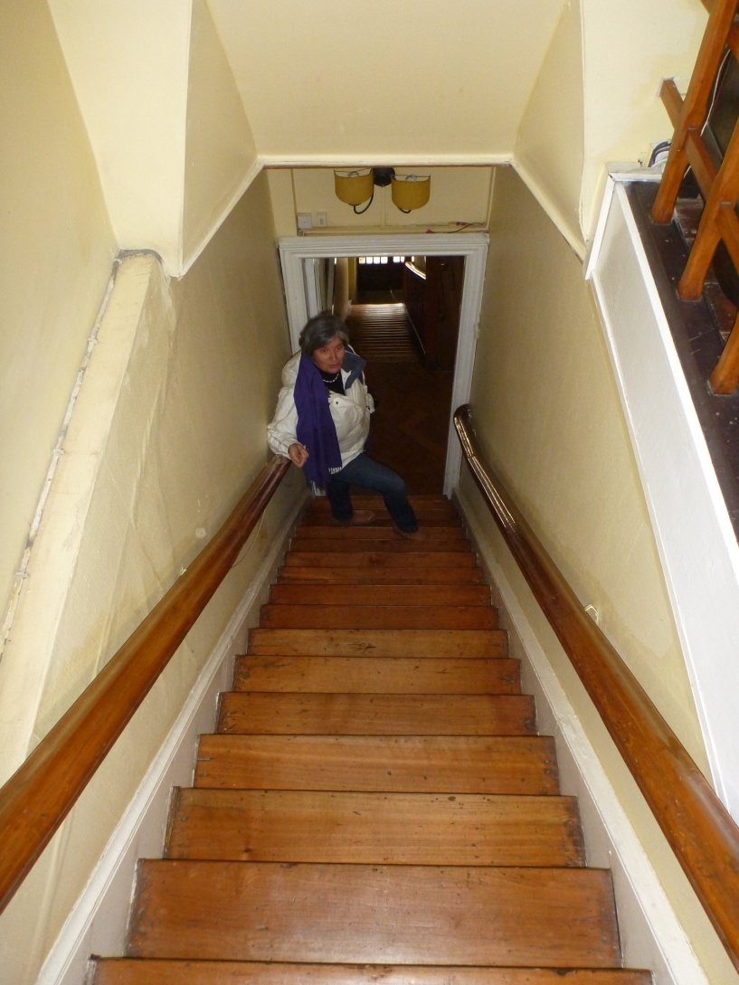
Stairway in B&B

Slide 34
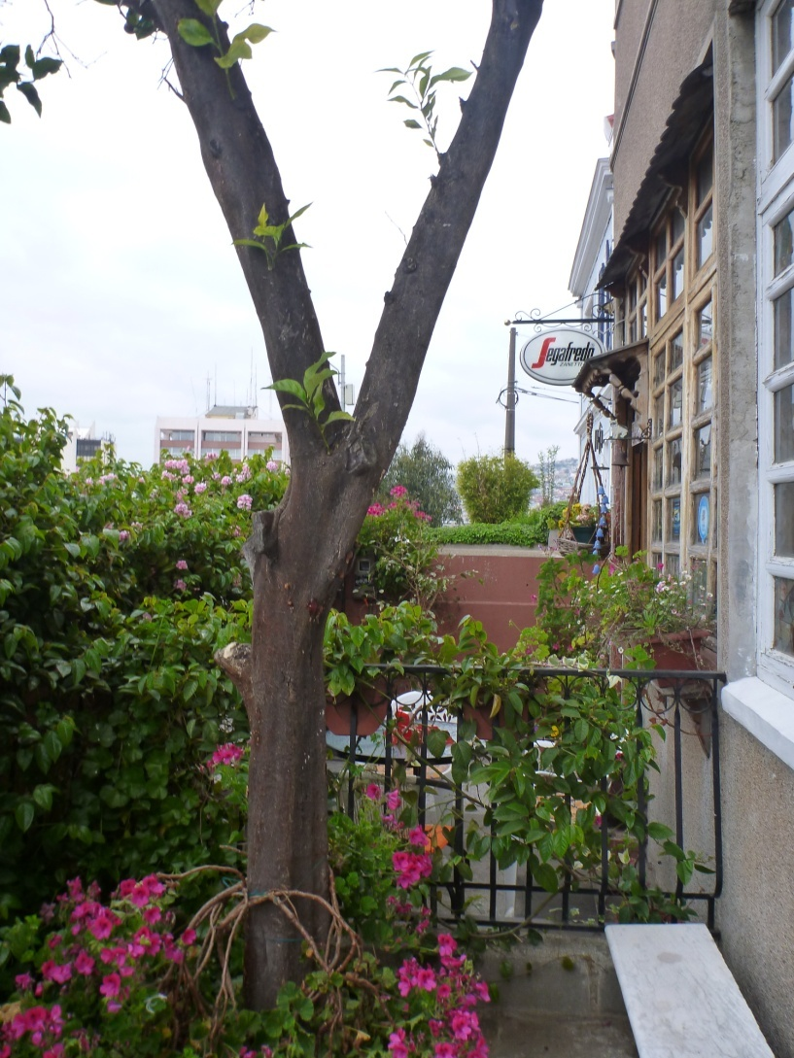
Café next to B&B

Slide 35
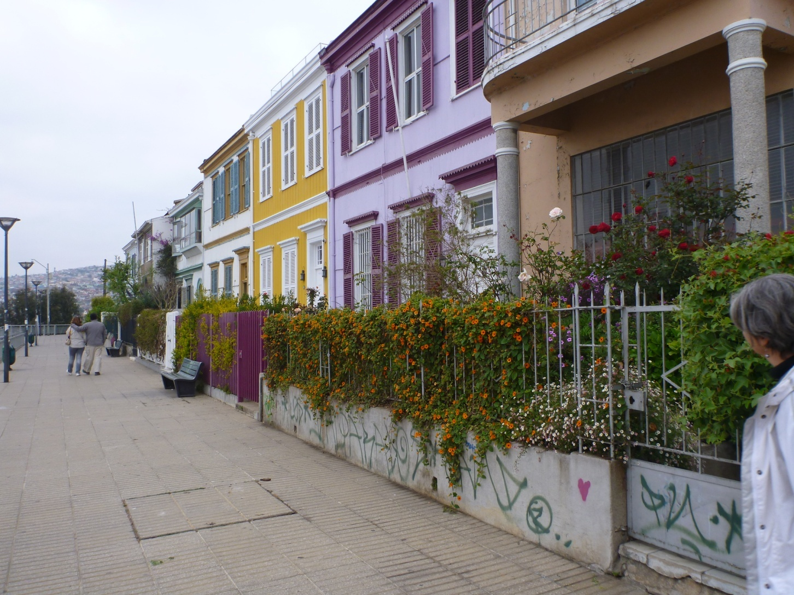
Walkway in front of B&B

Slide 36
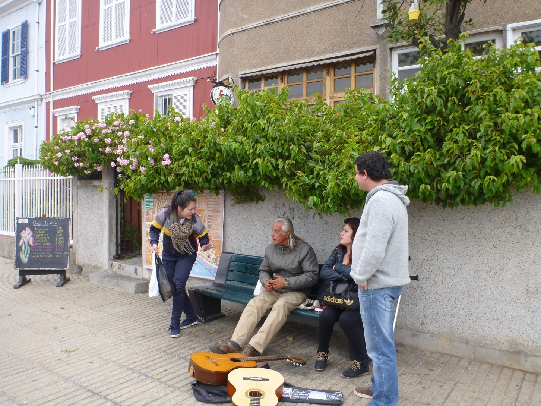
Street musician outside B&B

Slide 37
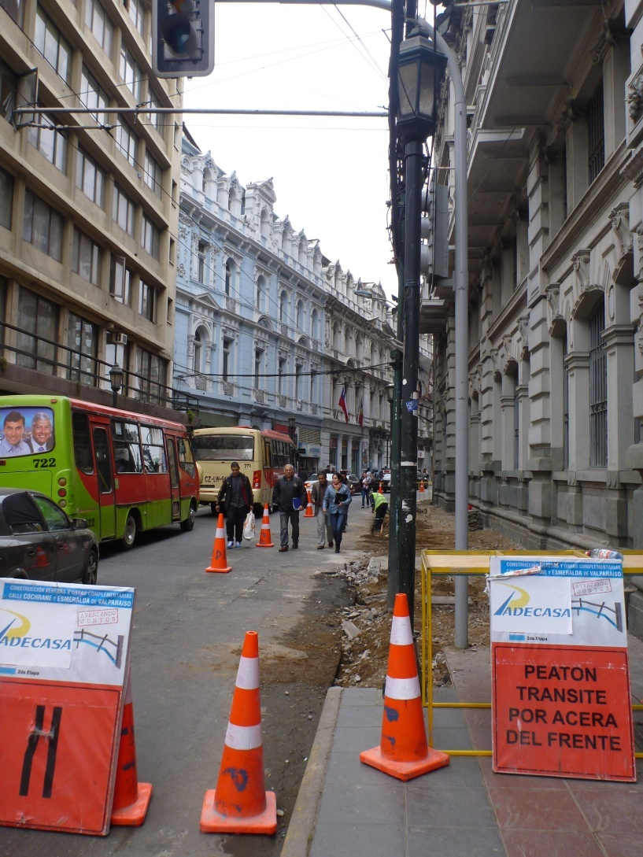

Slide 38
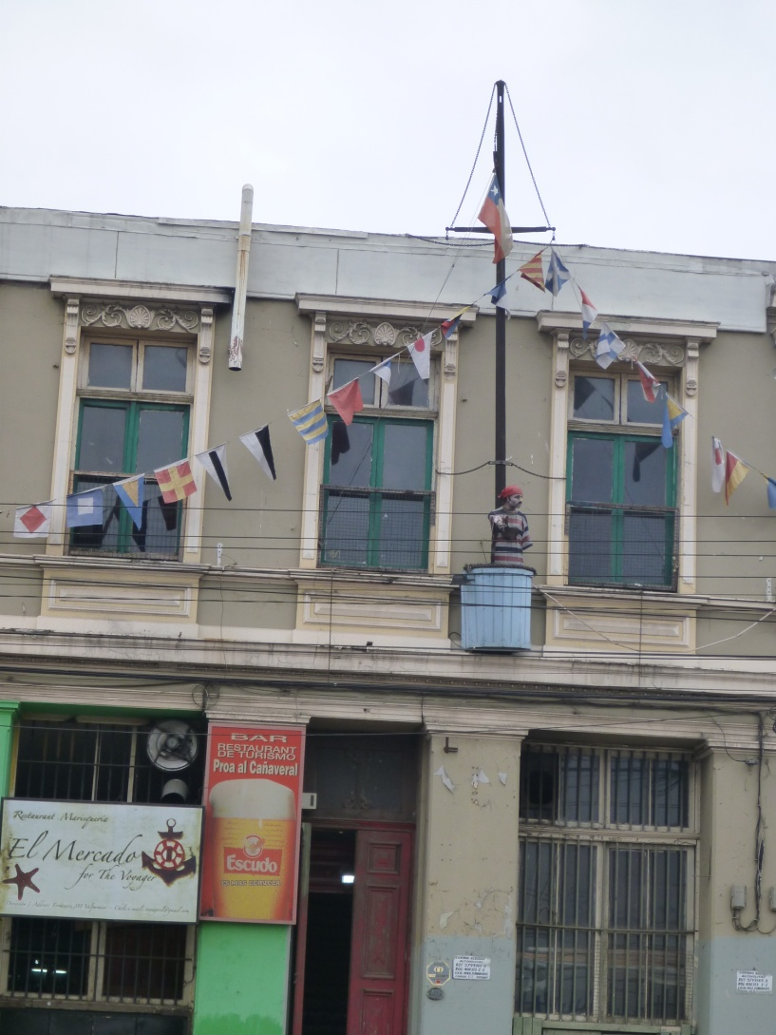

Slide 39
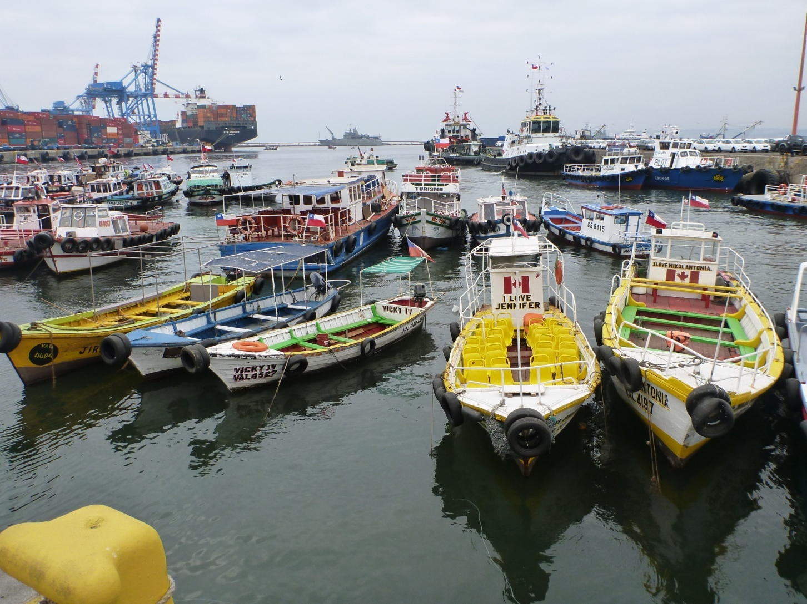

Slide 40
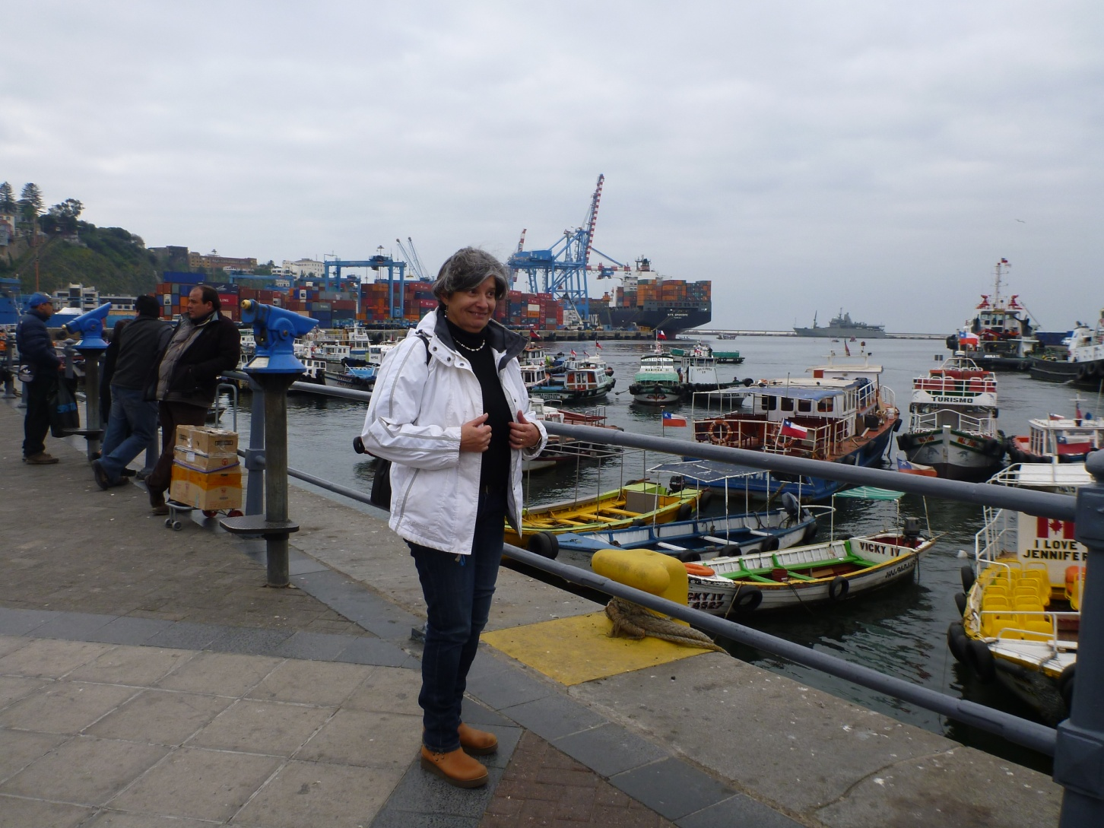
Graciala Raga

Slide 41
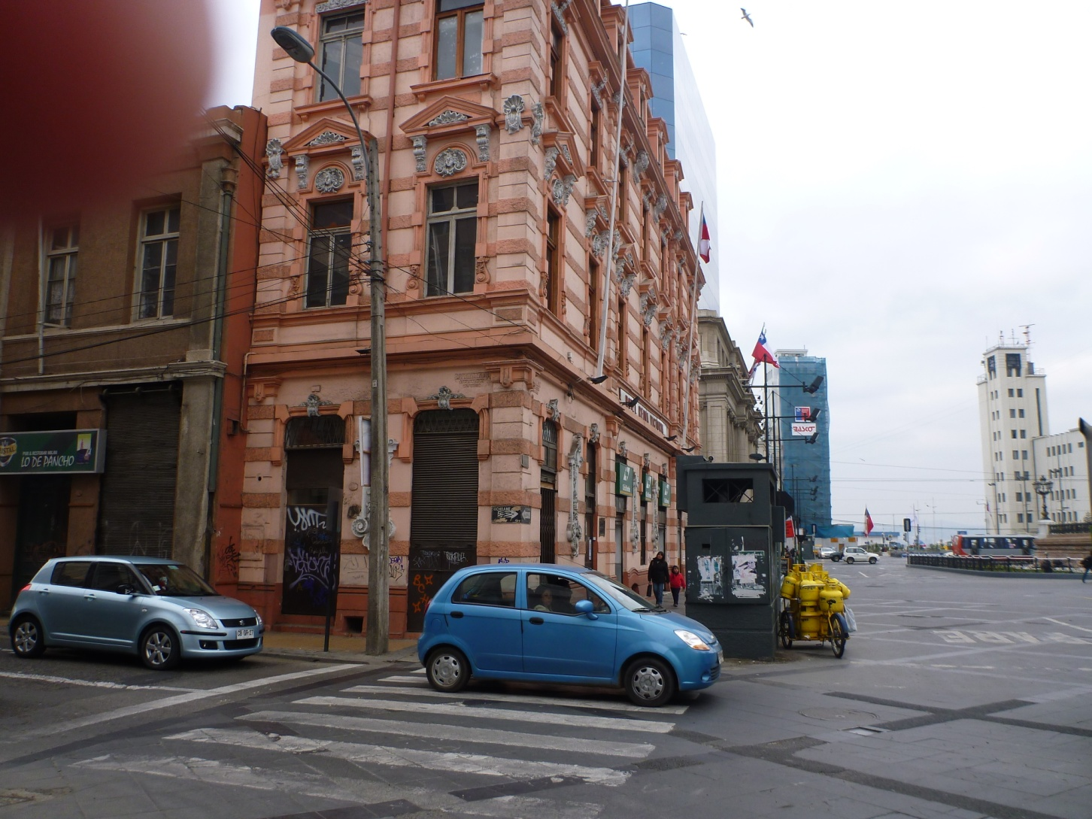

Slide 42
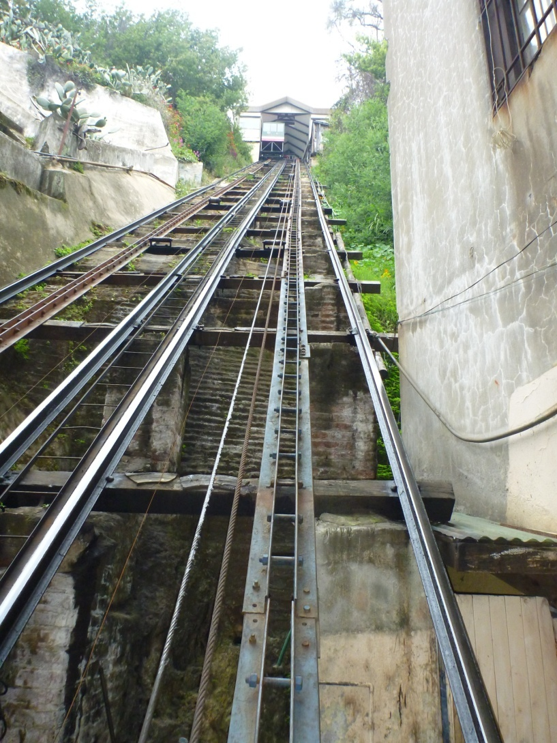

Slide 43
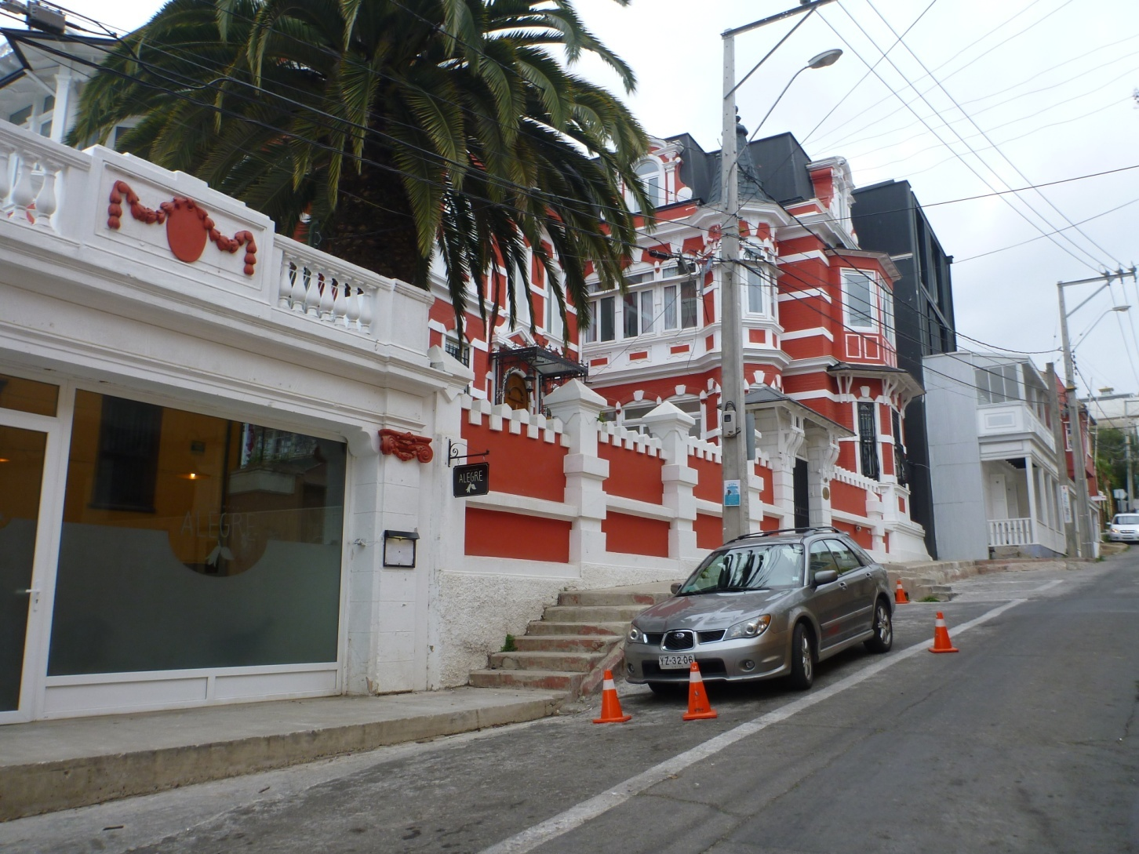

Slide 44
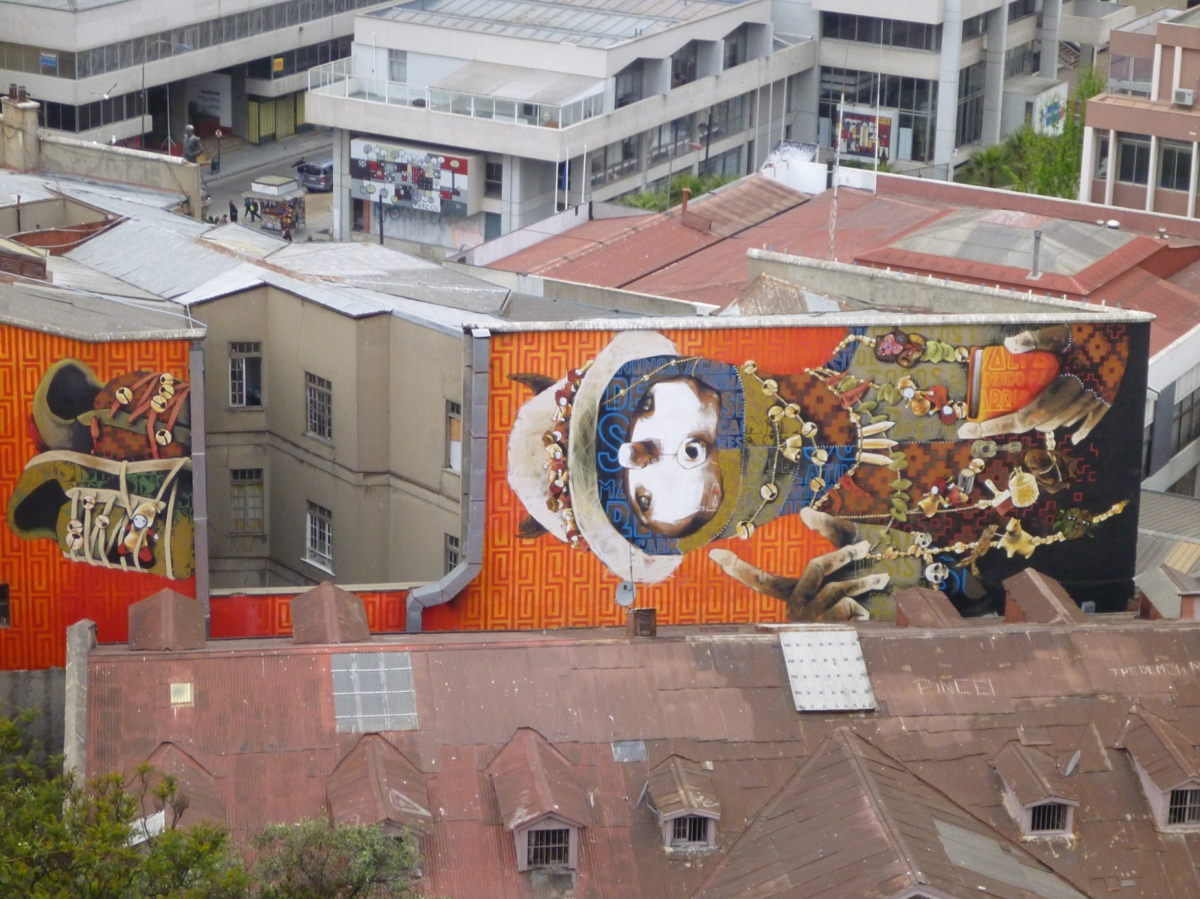
Murals

Slide 45
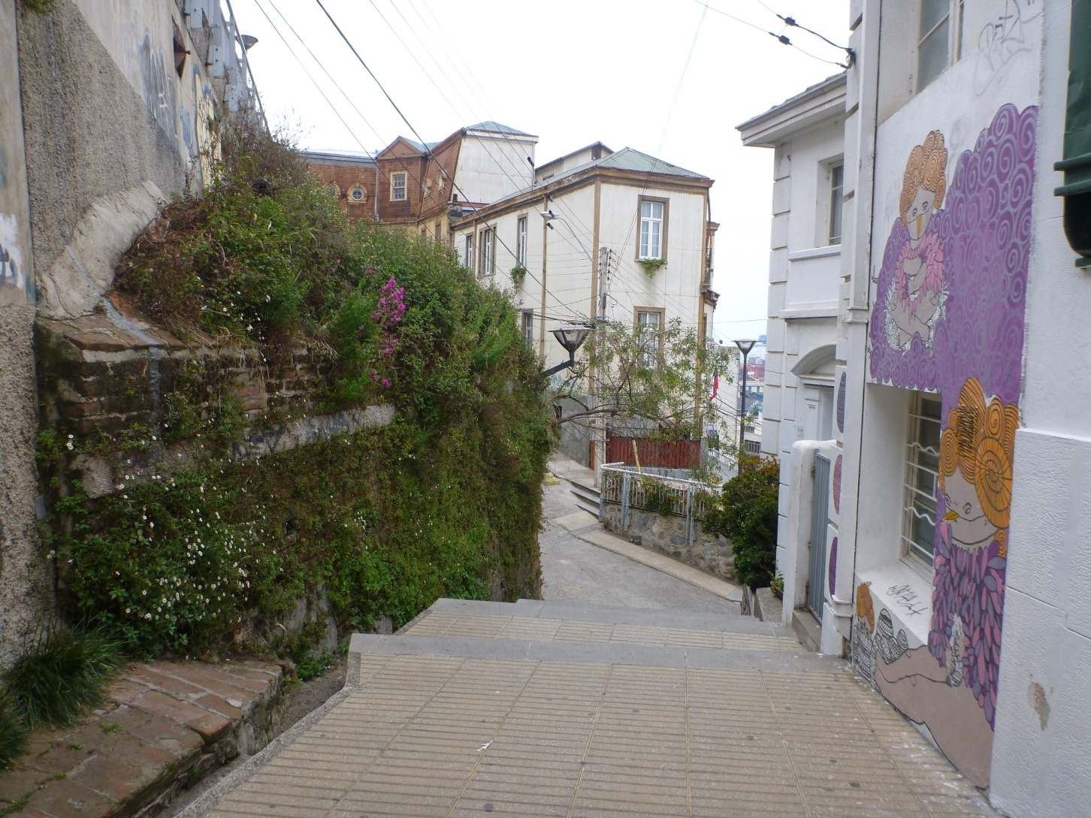

Slide 46
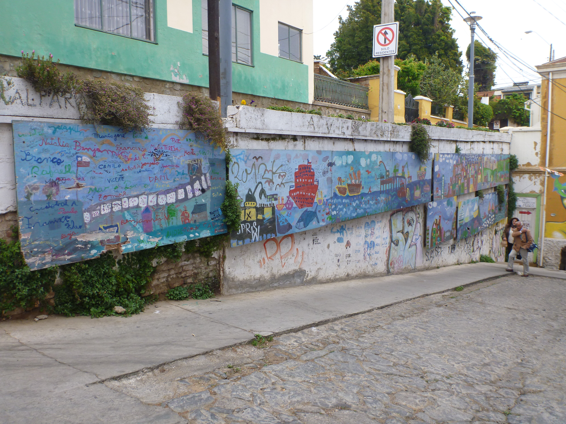
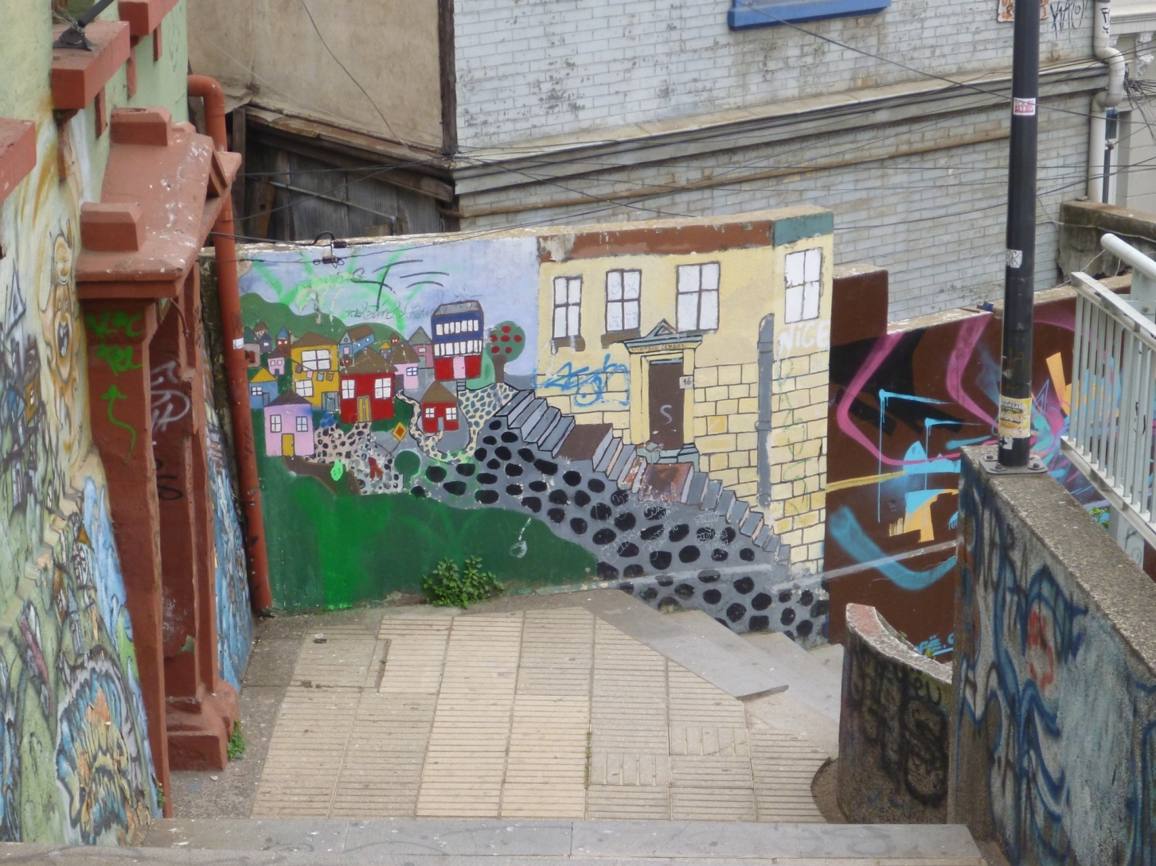

Slide 47
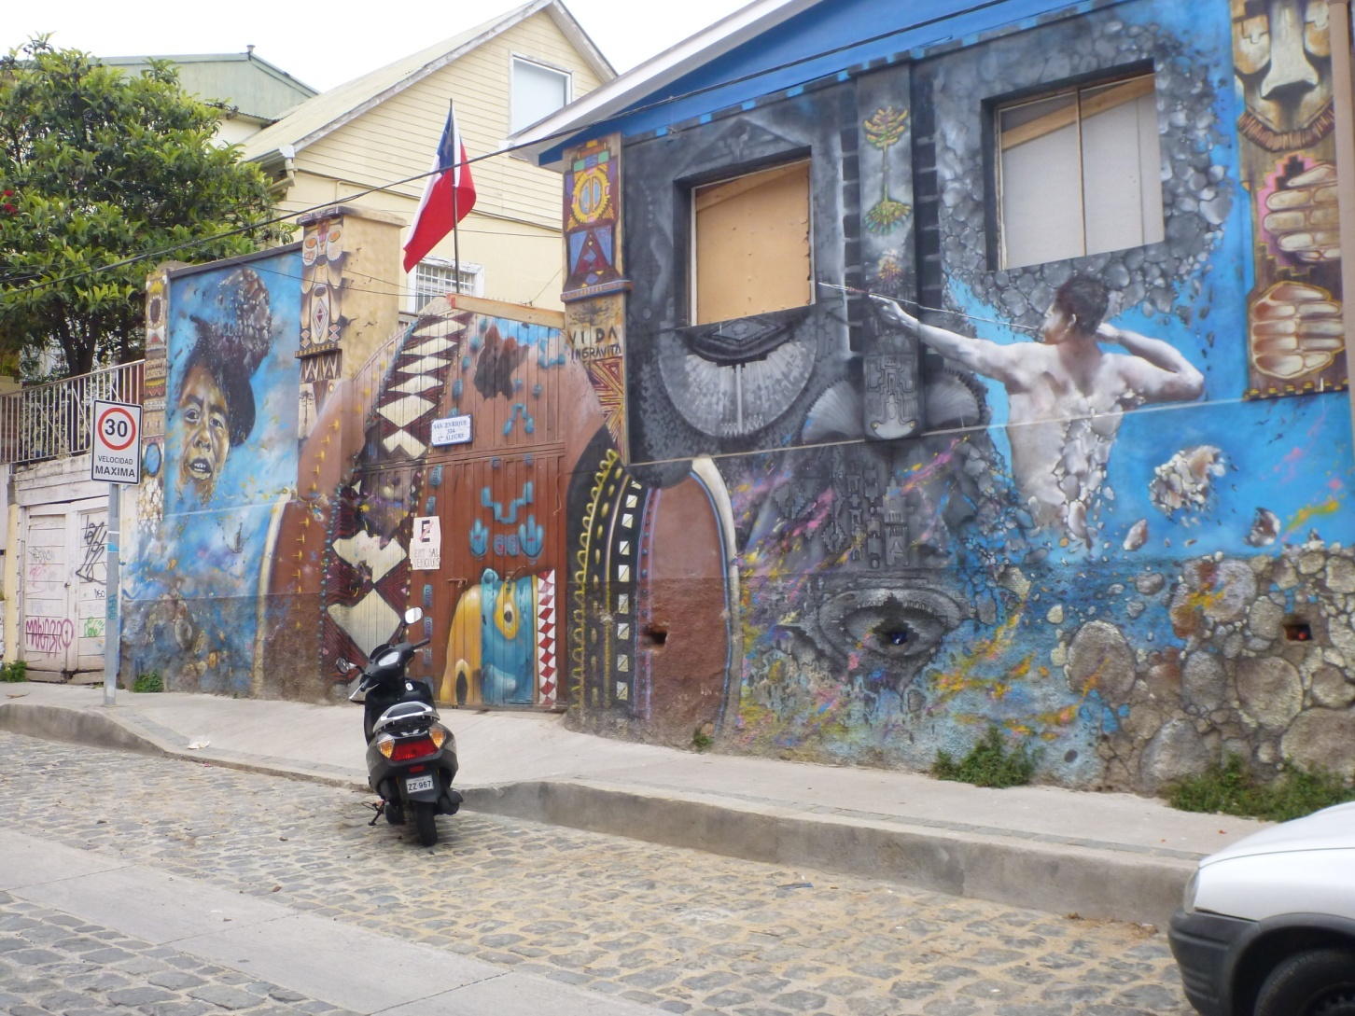

Slide 48
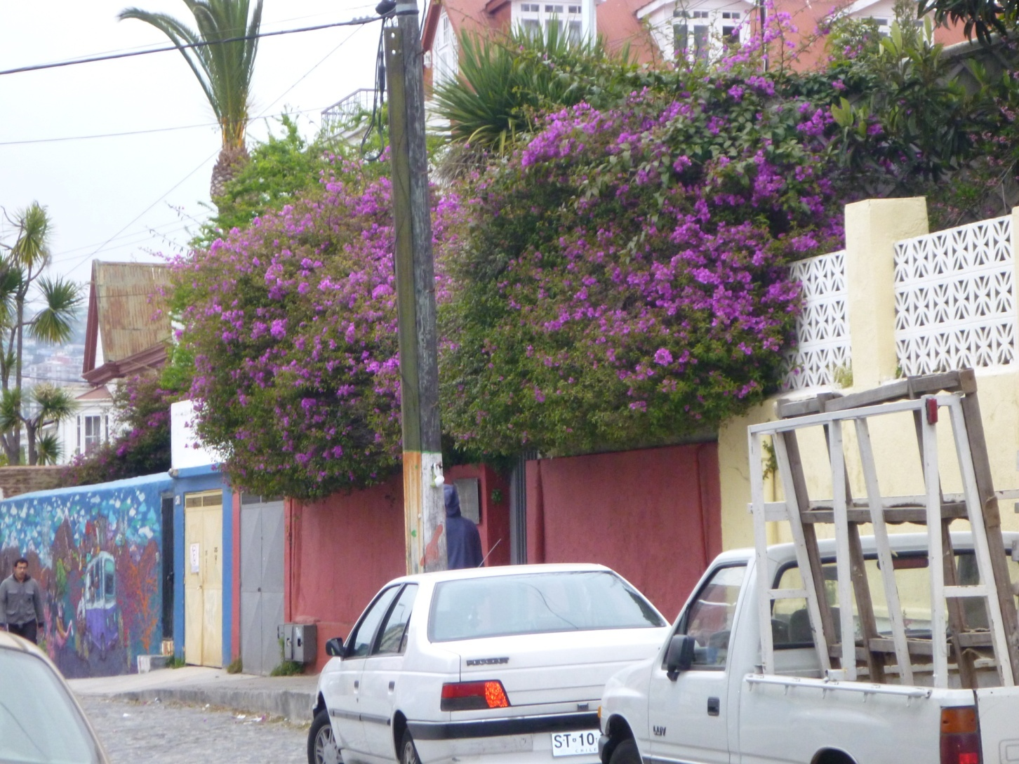

Slide 49
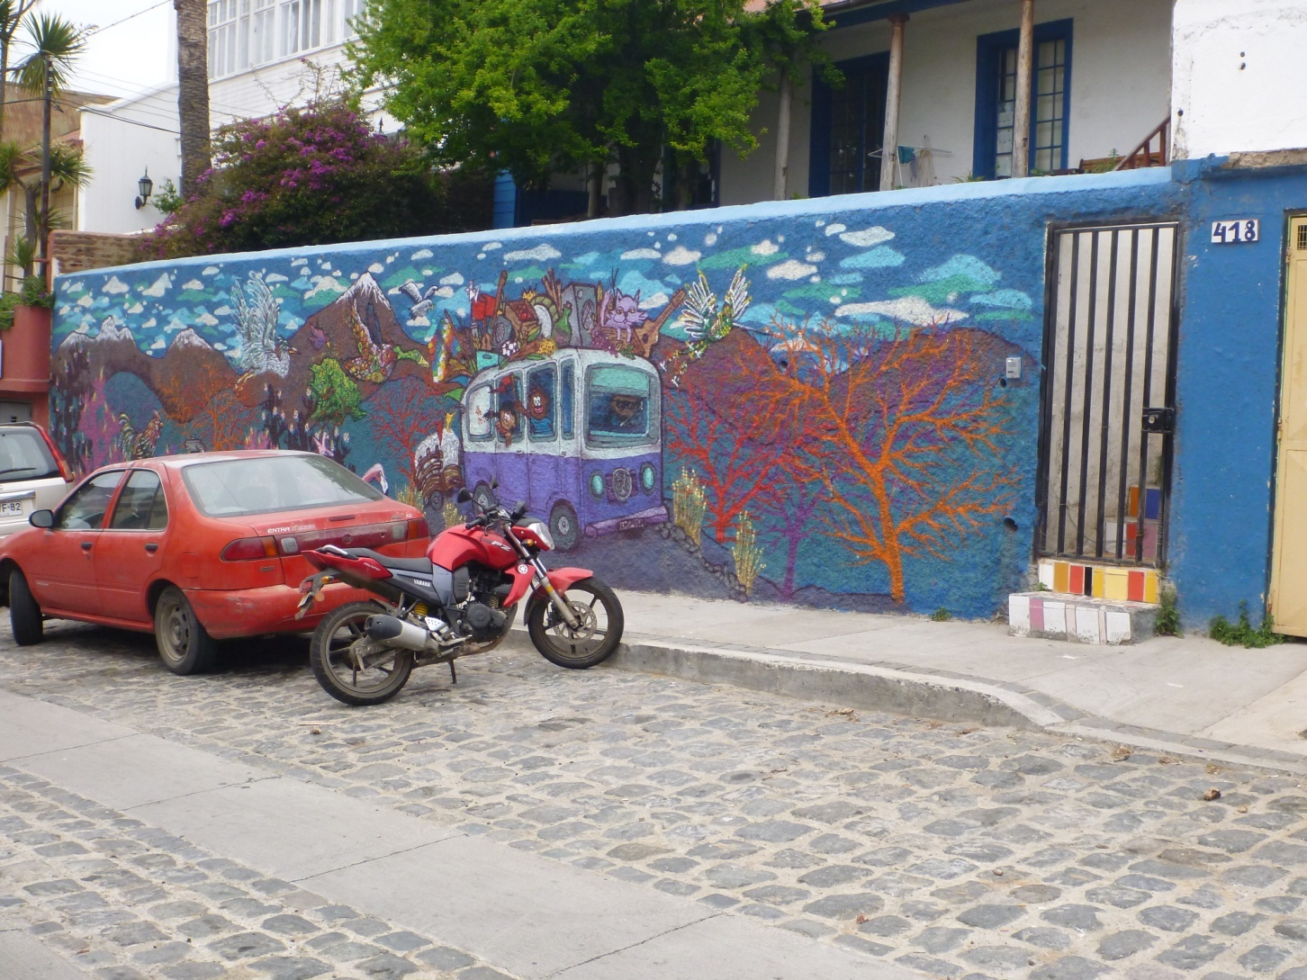

Slide 50
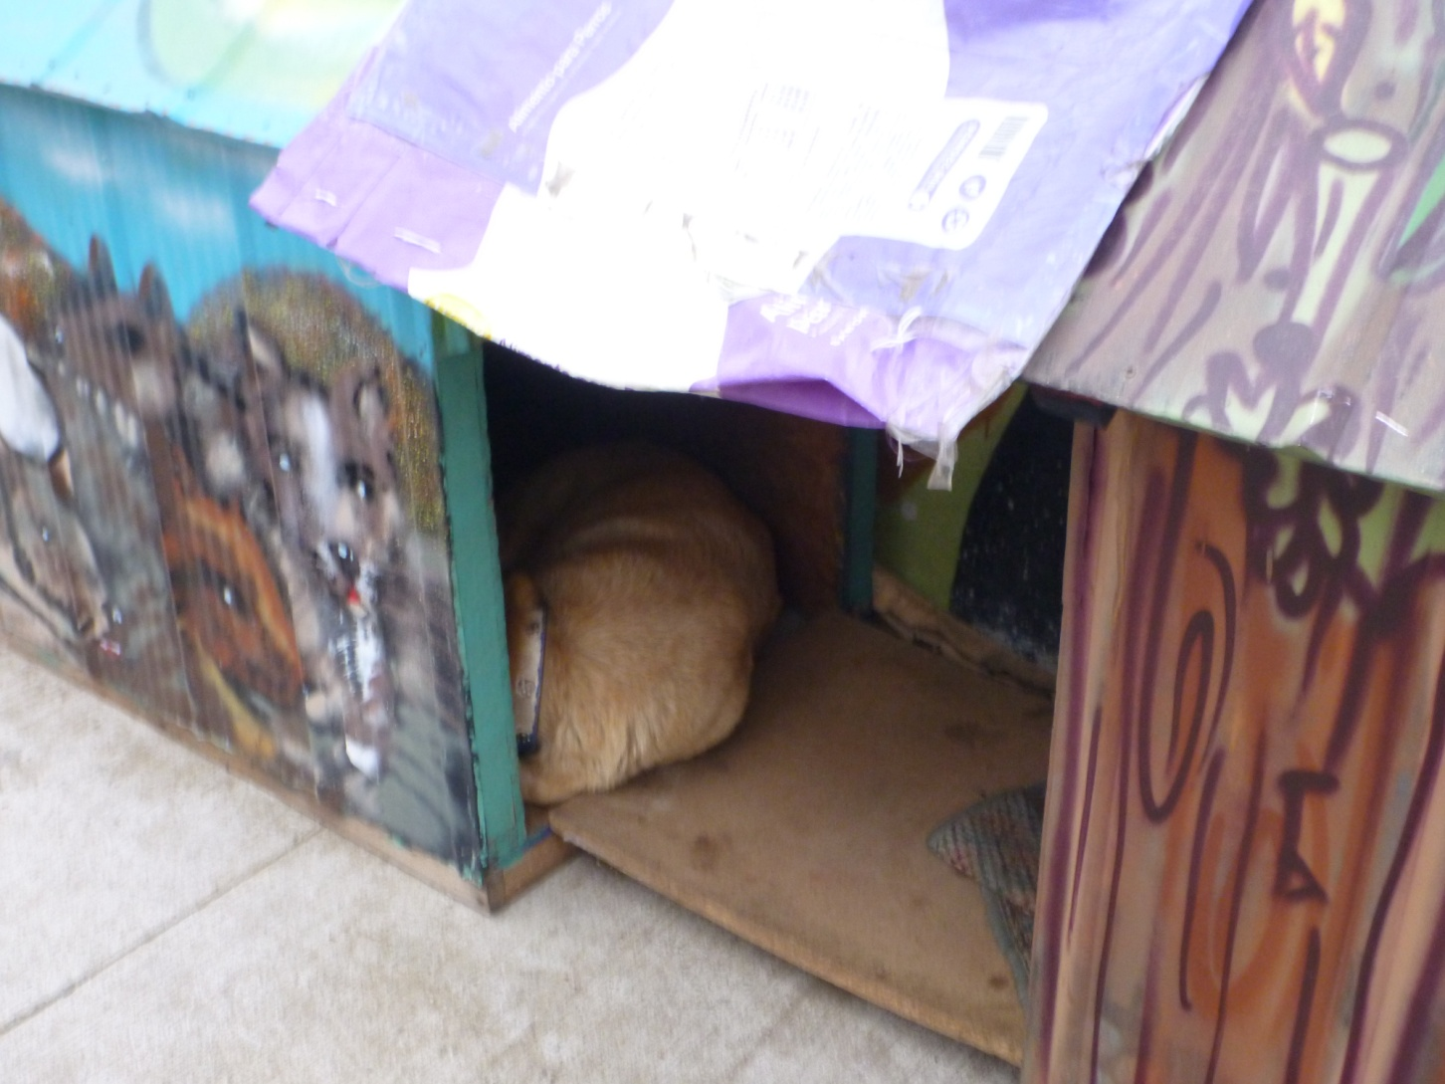

Slide 51


Slide 52


Slide 53


Slide 54


Slide 55

Home of famous poet

Slide 56


Slide 57


Slide 58

Lunch restaurant

Slide 59

Sunrise at B&B

Slide 60

Group photo at top of U Met Bldg

Slide 61


Slide 62


Slide 63


Slide 64

Met Dept

Slide 65


Slide 66


Slide 67


Slide 68

Bronzed poets

Slide 69


Slide 70


Slide 71

Back in Santiago: view from hotel

Slide 72

Park near hotel

Slide 73

Painting in restaurant

Slide 74

Homeless under bridge

Slide 75

Outdoor market

Slide 76

Indoor fish market

Slide 77


Slide 78

Bus tour

Slide 79


Slide 80


Slide 81


Slide 82


Slide 83


Slide 84


Slide 85


Slide 86


Slide 87


Slide 88


Slide 89


